Slide 1
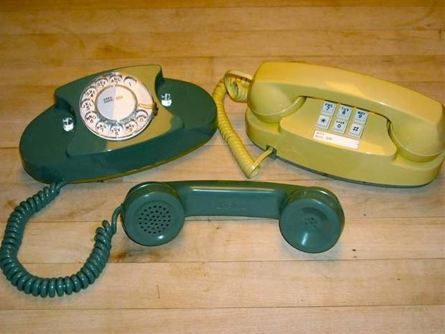
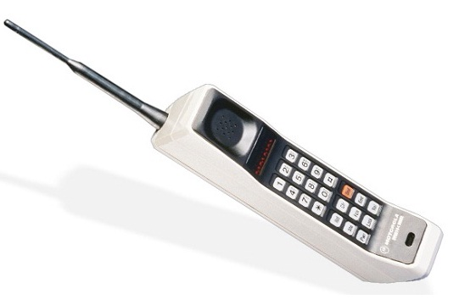
Teaching Introductory Statistics in a Digital World
The View from the Trenches
Friday, January 18, 2018
Joint Mathematics Meetings
Baltimore

Slide 2
Background
Notes:
Slide 9 is an important slide because it is the thing that helped me put a finger on where the disconnect between what my students need and what I was providing them come from. That point is repeated on Slide 11.
Slides 2-10 basically give a partial review of work I have done that qualifies me to have an INFORMED opinion on this. They are not really helpful for the actual presentation but rather to establish my authority, as limited as it is.

Slide 3
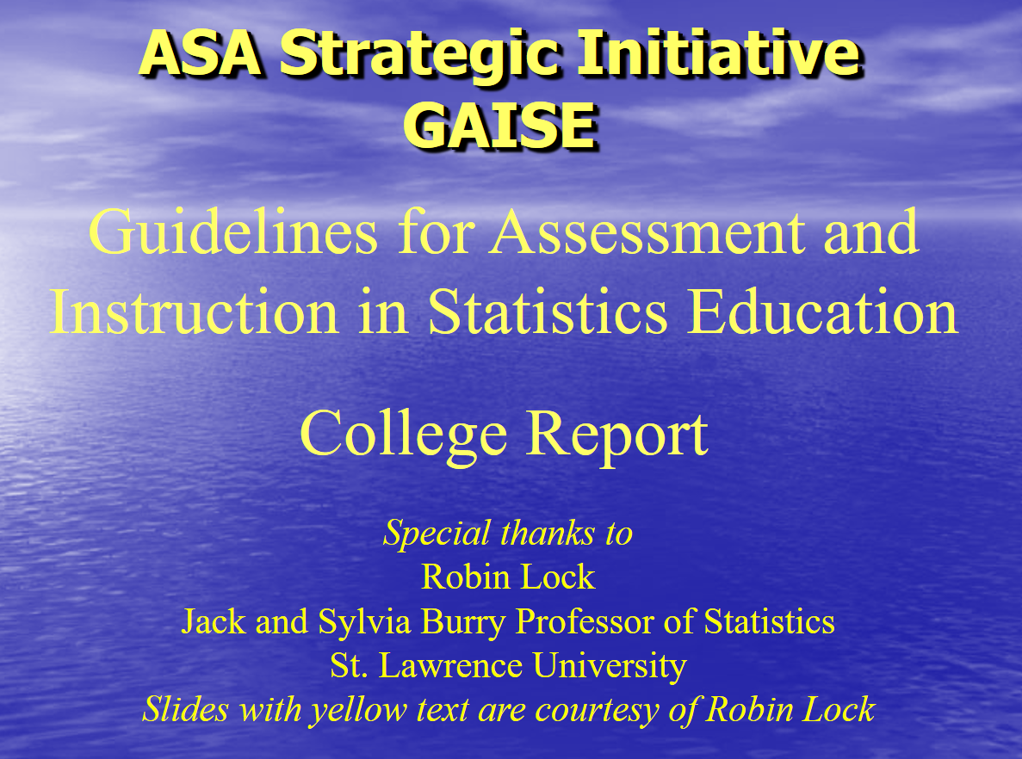
2008

Slide 4
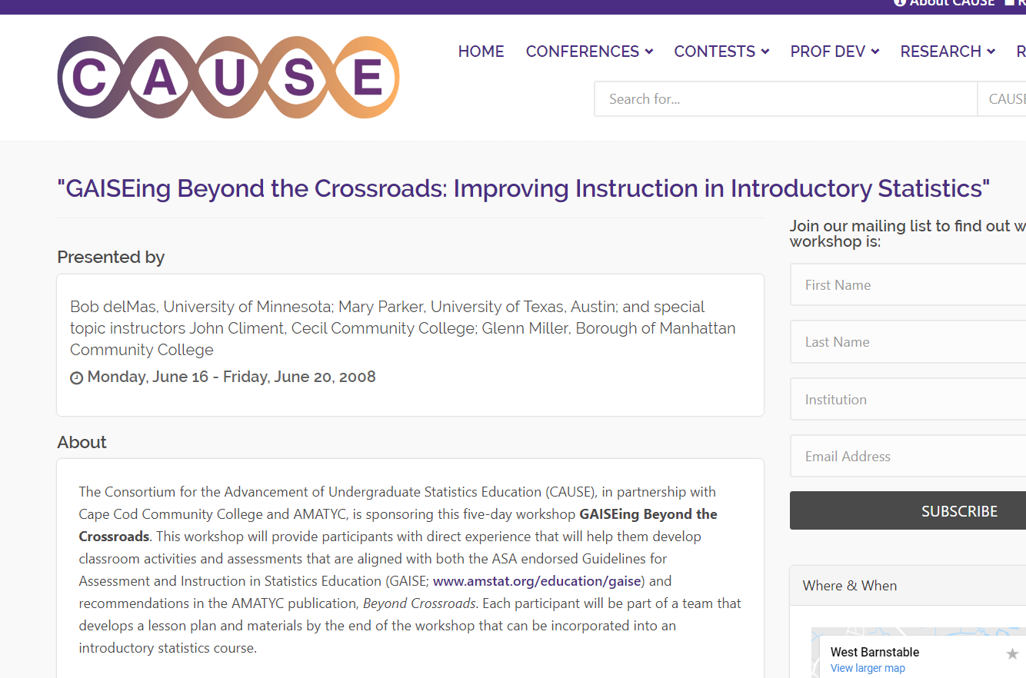

Slide 5
MAA Seaway 2008 Statistics Panel

Slide 6

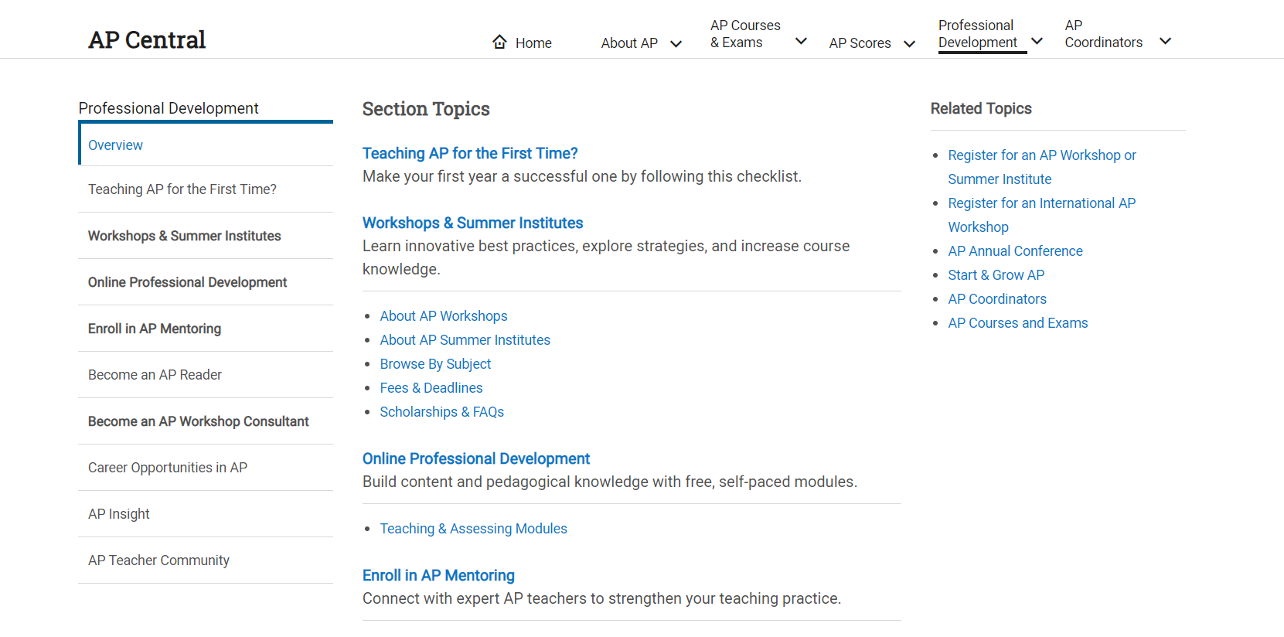
AP Statistics Reader, 2013-Present

Slide 7
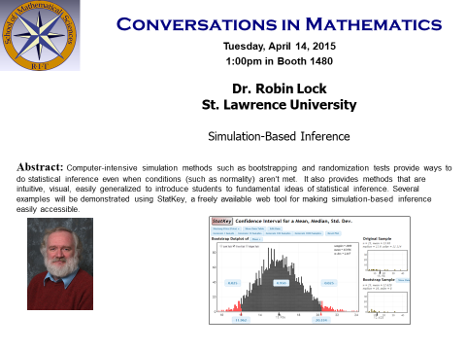
2015

Slide 8
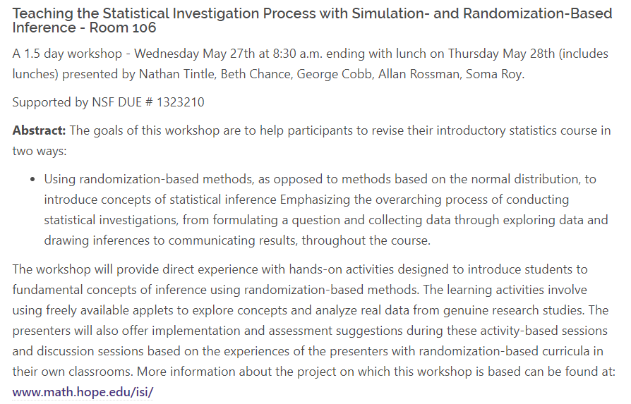
2015

Slide 9
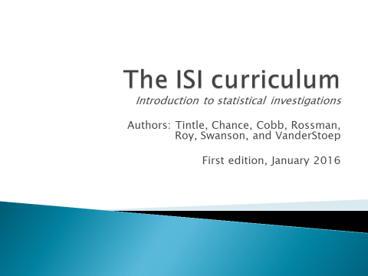
2016
Tintle made a distinction at this workshop that really resonated with me. He talked about students as being consumers of statistics or producers of statistics.
Notes:
This is an important slide because it is the thing that helped me put a finger on where the disconnect between what my students need and what I was providing them come from.

Slide 10
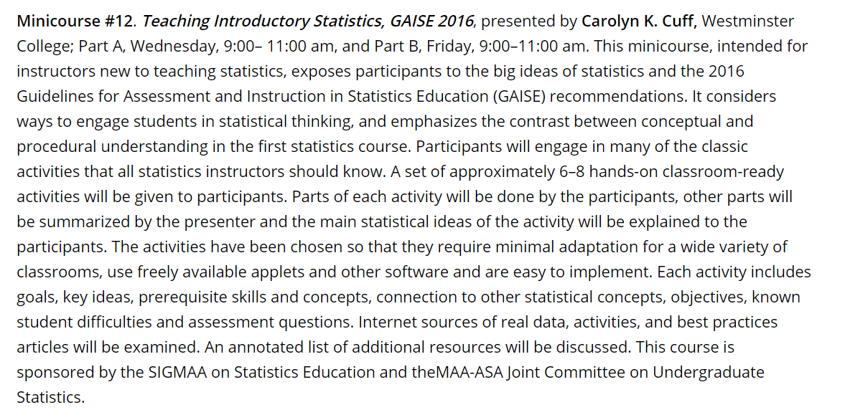
MAA – Stat Sigma 2017 Atlanta

Slide 11
After the 2017 MAA
After the 2017 MAA I was convinced that experts didn’t have the answer to the introductory statistics class my students need.
My students are both consumers and producers of statistics and of data.

Slide 12
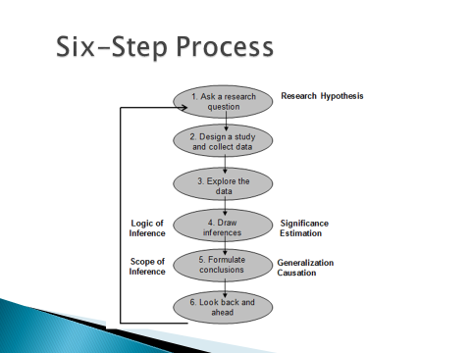
While SBI gives them great intuition on the means of a p-value,
it doesn’t teach them how to analyze data.
Students tell me,
I know which formula to use but I don’t know how to analyze data.

Slide 13
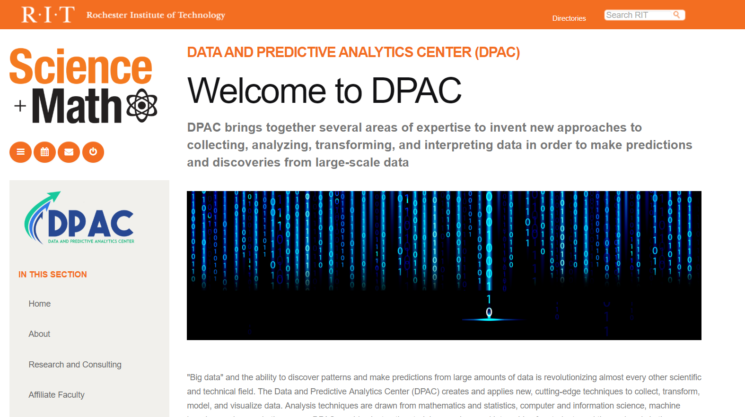
Data and Predictive Analytics Center (2016).
Notes:
When RIT established DPAC, I began exploring how to extend its activities to the intro level and to the general curriculum.

Slide 14
What’s New?

Slide 15
The first step was revising the intro stats curriculum.
Notes:
I co-chaired a committee to re-write the intro stat course outline so that our “contract” with the students allowed us to change what we were doing in class. Here is a side by side comparison. In the new version, I starred (*) parts that most of our faculty could not yet do. I wanted to make it “legal” to offer the new curriculum but not penalize people for now YET knowing how to teach it. It passed.

Slide 16
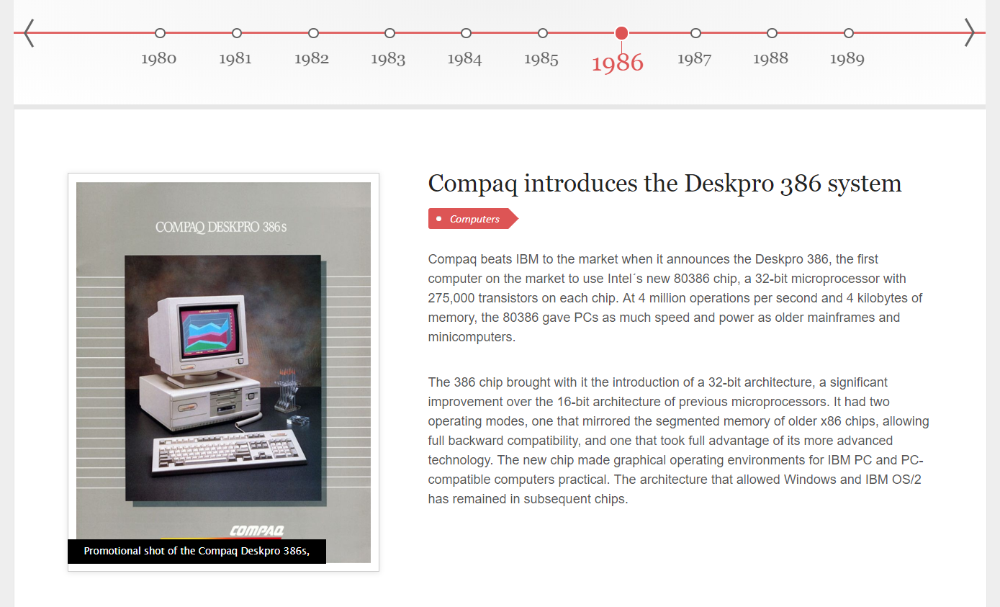
How did we get here and why change?
The course we have been teaching for years grew up in a historical context.
That context has changed.
Technology has changed.
Notes:
Evolution always takes place in a context. Something changes which causes other things to adapt and change and so the process continues. Our traditional curriculum has merely been tweaked since the 1980s. Technology has completely transformed the world. In 1986, personal computers were a novel thing. We have come a long way since then.

Slide 17
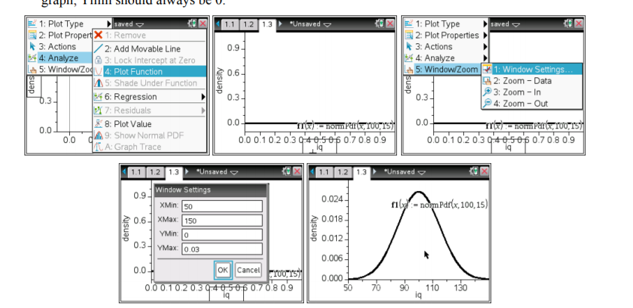
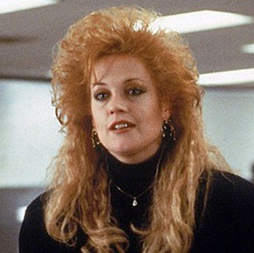
We have updated our other tools.
So why do we do this?
We don’t do this anymore.
Don’t get me started on TI’s Incentive System!
Notes:
Data isn’t tidy and it doesn’t come from a textbook.
Data sets are too big to be practically analyzed with a calculator.

Slide 18
Not All roads Lead to Inferential Statistics.
REAL Data is not always a random sample.
Often what we have is “the” data so we can’t make the traditional distinction between the sample and the population, between descriptive statistics and inferential statistics.
Notes:
In the current dominant model of intro stats, all roads lead to inferential statistics. We all know the reasons why it has been done this way. However, this is NOT the world our students live in today.

Slide 19
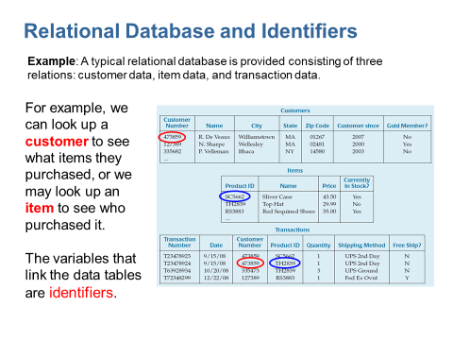
Data Sets aren’t rectangular arrays
Often data is stored in a relational data base for efficiency. When we want to use a rectangular array, we need to wrangle it into that form.
We need to at least show them how a relational data base works.

Slide 20
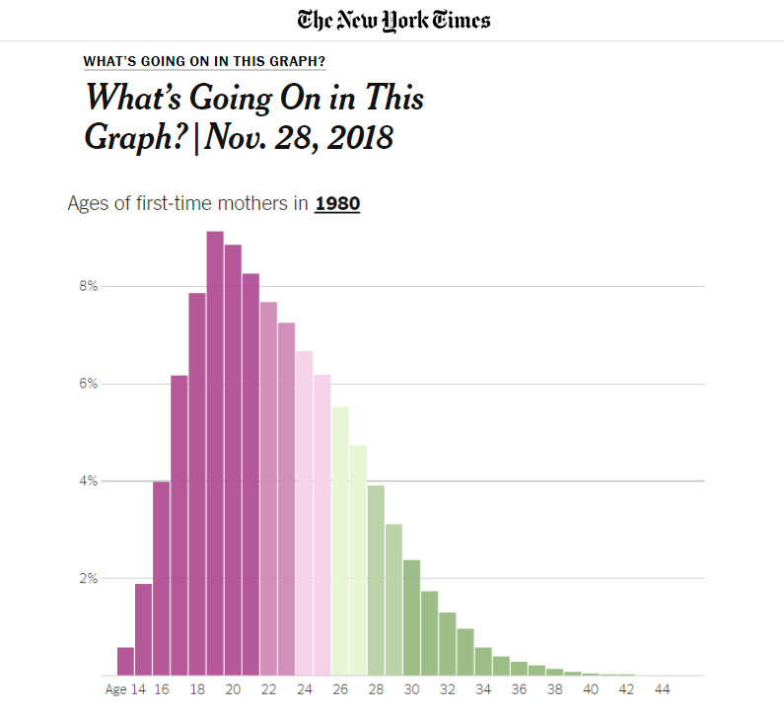
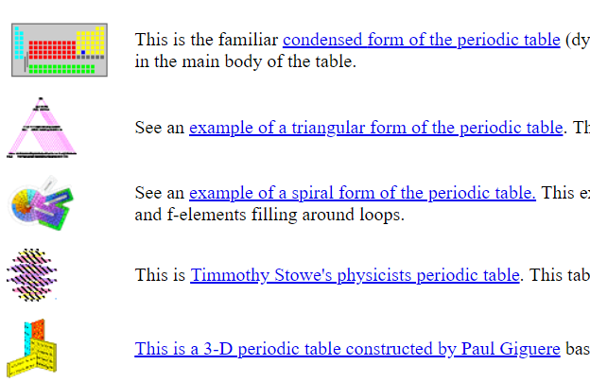
Data Viz is everywhere.
https://www.wou.edu/las/physci/ch412/alttable.htm

Slide 21
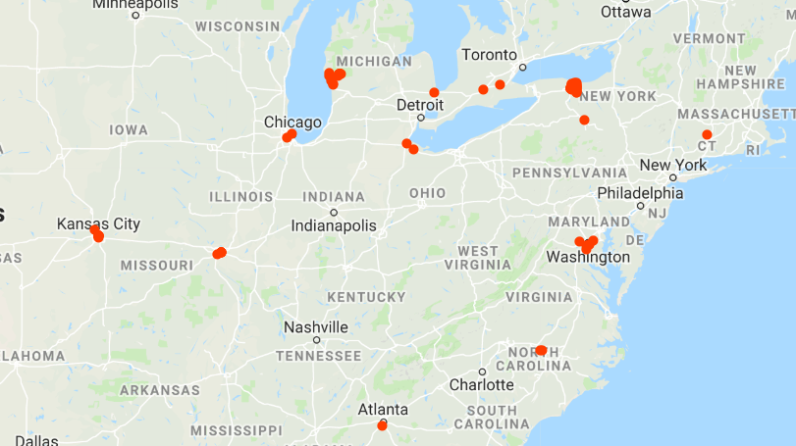
Data: not just Quantitative and Qualitative anymore.
  Google can show where we have been in the last year.
  The classes we teach need to reflect that.
  Images are data, location is data, signals are data.
Notes:
Checking into your favorite hangout is data as is your shopping patterns, your search history and who knows what else.
Students get INTERESTED in data analysis and predictive modeling when you explain how THEY are providing training data every time they pick up their phone.

Slide 22
So, what do I do?

Slide 23
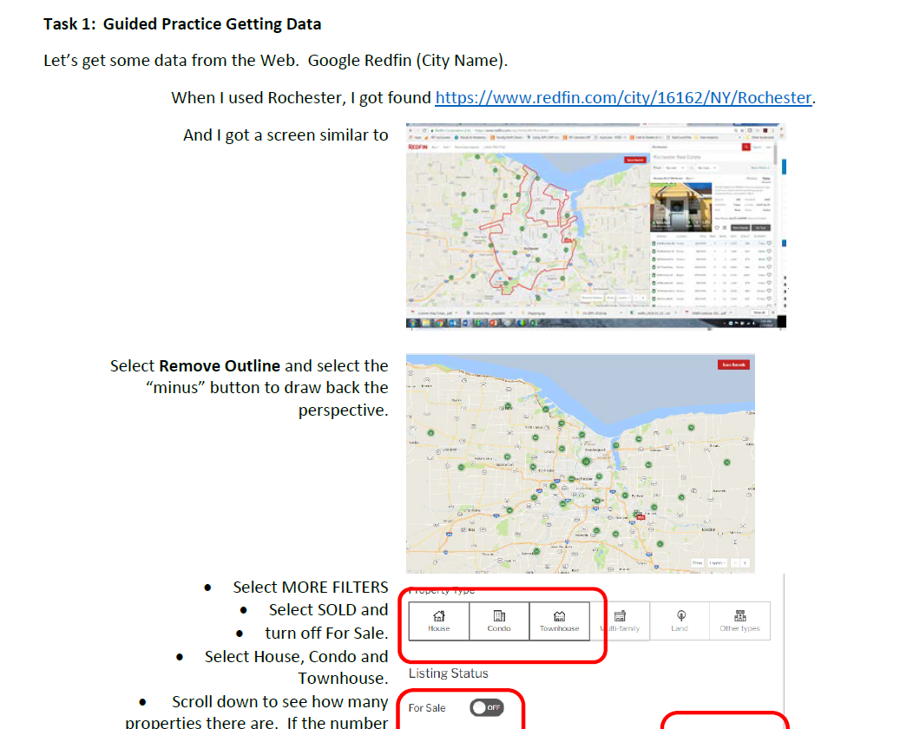
Day 1
I did this the first 15 minutes of class.
Notes:
As soon as I can, I get them playing with data that they can relate to. I have them Google “REDFIN and their home zipcode” and then download a rectangular data set of real estate data from their home town.

Slide 24
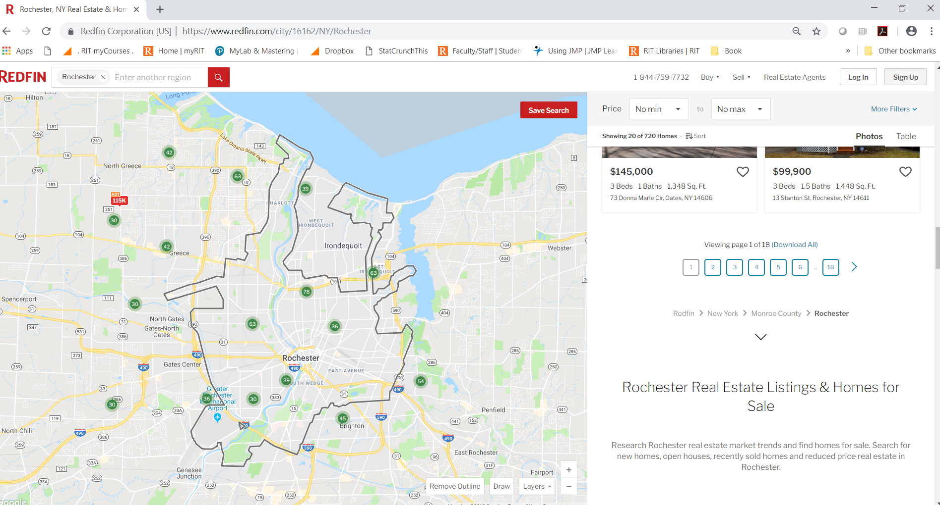
Notes:
After they download the Excel file, I have them open it in JMP.

Slide 25
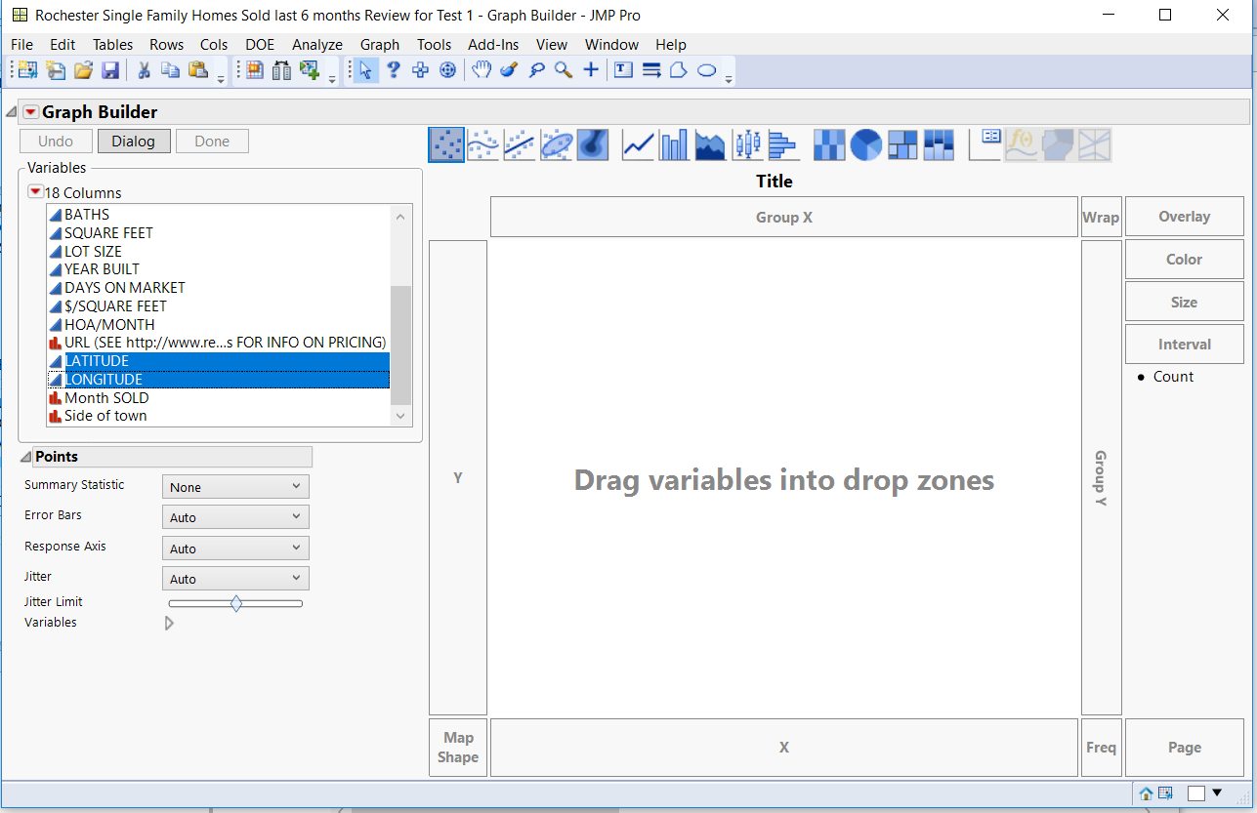
Notes:
In JMP, I have them drag Latitude and Longitude into the center of the graph builder window and then pull in a background map.

Slide 26
Notes:
Here is an example from Rochester NY, where I have color coded according to “groups of cities”. When they start, it will all be black dots. By the time I get this far, they are dragging over variables to explore the real estate data from their home town and talking to one another about how they are using to software to answer questions they have about their town.

Slide 27
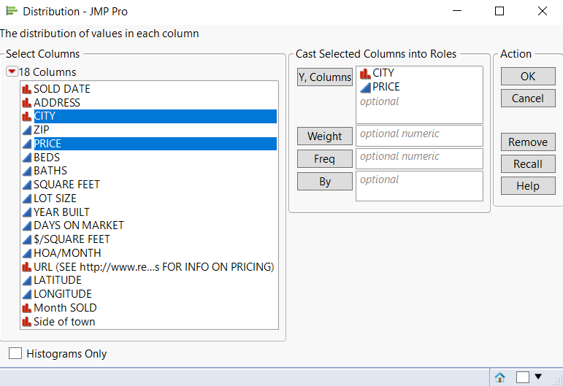
Notes:
Then I have them us the distribution platform for one categorical and one quantitative variable and ask them to discuss what they see with their neighbor. What is the same between MY 2 graphs, what is different? What is the same between MY bar chart and YOUR bar chart, etc.? And now they have questions they want me to answer.
They are READY TO LEARN.

Slide 28
Exploratory Data Analysis
is more important than ever before.
We have to catch up. They have been doing univariate descriptive statistics and basic probability since grade school.
Why do we recover that ground instead of teaching Heat Maps, Mosaic Plots, Bubble Plots, and Interactive Graphics .
Notes:
Univariate Data Analysis isn’t enough.

Slide 29
Heatmap
Notes:
The table and the heat map convey the same information. Which communicates the information faster? (i.e. lightens the cognitive load)? I have been told that students won’t understand heatmaps but they have been interpreting weather maps since they were kids. It’s the same thing.

Slide 30
Most students can’t see a distinction.
Notes:
Most students can’t see a distinction between these graphs. They use the same variables. And even if they can see they are different, they say “who cares” . They don’t care if its points or percents or what it is the percent of – until it comes to their final grade. THEN they really pay attention to details.

Slide 31
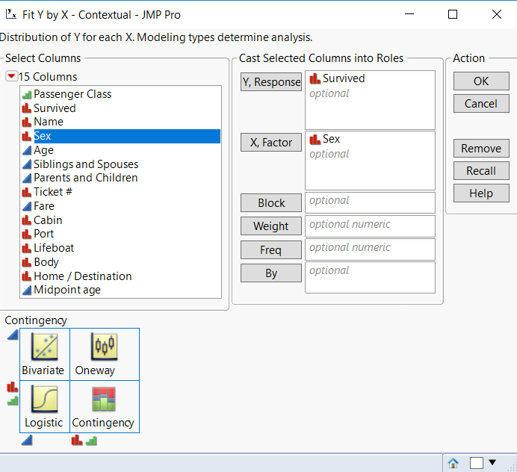

Slide 32
Multivariate Analysis is a MUST.
Notes:
But we can go beyond traditional bivariate analysis with interactive graphics.
Why are we stuck using a Batch Program when an Interactive one is available?

Slide 33
We can go beyond simple regression.

Slide 34
Notes:
Multiple regression with an indicator as the second predictor can be explained visually, making it easier for students to understand the meaning of a regression coefficient.

Slide 35
Notes:
We can even introduce the idea of an interaction term both visually and with the equation. The equation takes on meaning.

Slide 36
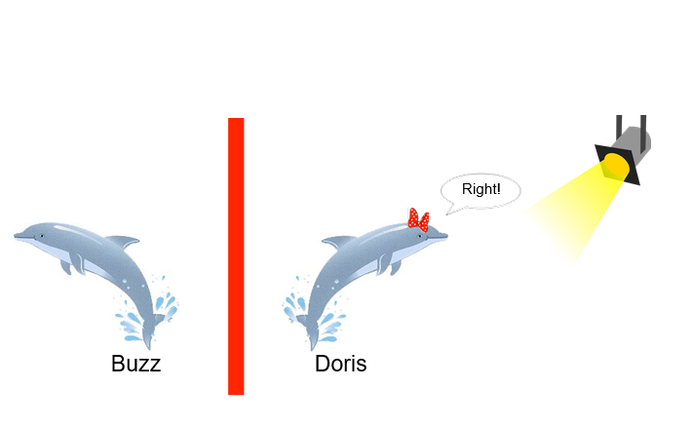
Go Light on Traditional Probability.
They already know proportions and odds ratios.
That is enough to understand a p-value at a very basic level.
Simulation Based Inference can provide the foundations of Inference rather than getting bogged down in Probability.
Notes:
They walk into our class with an understanding of odds ratios that we ask them to forget to do traditional probability. Then we have to teach it to them again before we can introduce logistic regression.

Slide 37
The Proposal to Lower P Value
Thresholds to .005
JAMA. Published online March 22, 2018. doi:10.1001/jama.2018.1536
"Moving the P value threshold from .05 to .005 will shift about one-third of the statistically significant results of past biomedical literature to the category of just 'suggestive.' This shift is essential for those who believe (perhaps crudely) in black and white, significant or nonsignificant categorizations. For the vast majority of past observational research, this recategorization would be welcome."
https://jamanetwork.com/journals/jama/fullarticle/2676503?utm_source=twitter&utm_campaign=content-shareicons&utm_content=article_engagement&utm_medium=social&utm_term=032218#.WrQS3lm-Ma0.twitter
Notes:
Data isn’t scarce and students know it. They can see in the test statistic formula that when you increase sample size you increase the test statistic and thereby lower the p-value.

Slide 38
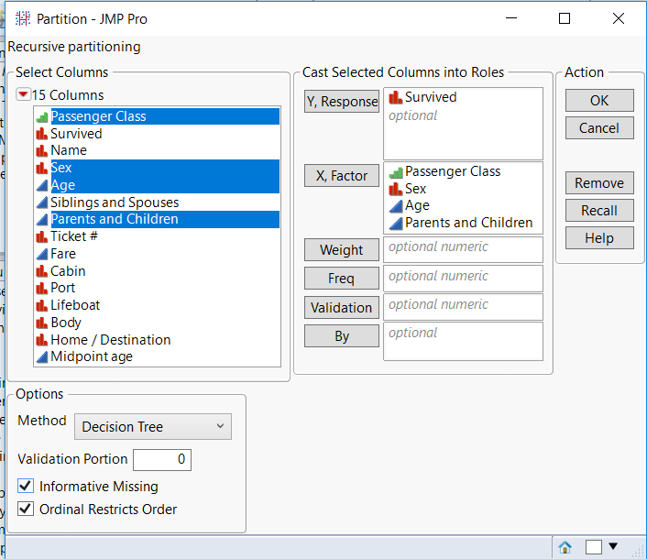
Decision Trees invite exploration of Simpson’s Paradox.
Notes:
Partitioning is not difficult with appropriate technology.

Slide 39
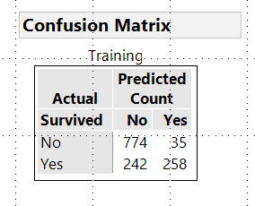
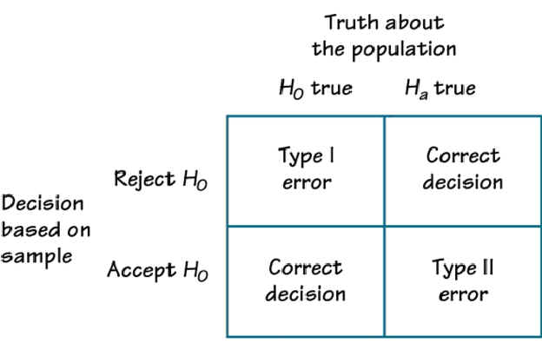
The Confusion Matrix is NOT Confusing.
Using Titanic Data
The traditional approach is very clever. It uses a lot of logic. But do they understand what it would imply in another context?
Notes:
Go Light on Traditional Probability.
Partitioning and cross validation are not difficult with appropriate technology.
After a confusion matrix with the Titanic data, they have a context for Type I and II errors when we get to it in Hypothesis Testing.

Slide 40
Decision Trees invite exploration of Simpson’s Paradox.
Notes:
Only 38% of ALL passengers survive.
72.67% of FEMALE passengers survived.
Nearly 93% of 1st and 2nd class female passengers survived, compared to 49% of 3rd class female passengers.
More than 58% of young male passengers (under 10) survived, a larger % than 3rd class female passengers.

Slide 41
Notes:
Why Change?
Students get INTERESTED when you explain how THEY are providing training data every time they pick up their phone.
They UNDERSTAND why DS is important when you tell them it is what is used when Amazon recommends they buy something.
They feel EMPOWED when they see AND understand how Data Science is used in their daily lives.

Slide 42
Notes:
On Day 1 they played with real estate data from their home town. By the end of a 5 week summer session, they were going beyond what is required for stat 1. They were asking me HOW to do things they wanted to do.

Slide 43
Inferential Statistics is not the only game in town.
Explanatory Modeling v. Predictive Modeling is not above their heads.
To not mention Data Science in this day and age is intellectually lazy or dishonest.
Notes:
Philosophers and Journalists are talking about it.
If we don’t, we are making ourselves irrelevant.

Slide 44
Reproducibility Crisis.

Slide 45
Jan 1, 2019 1:18 AM
Certainly a lot of the reproducibility issue with social science studies arises because studies of people inherently involve greater "between subject" variability than physics or physical chemistry experiments. However, there are many other practices that lead to lack of reproducibility as well. These include poor study design, poor choice of measure, and poor or inappropriate statistical practices in analyzing data.
------------------------------
Martha Smith
University of Texas
------------------------------
Obviously we are party animals!
Notes:
This continues to be a hot topic today. From the ASA community.

Slide 46
Jeffrey Flier, former Dean of Harvard's Medical School at the National Academy of Sciences. He indicated that there is a "statistical deficit" to include a lack of sufficient statistical awareness; and what some view as inadequate training in statistics. The inadequacy is especially evident in clinical research (Dialog and Reactions, Arthur M. Sackler Colloquia 2017).
------------------------------
Esther Pearson
Assistant Professor
Lasell College
Notes:
More from the ASA community.

Slide 47
"Insanity is doing the same thing over and over again and expecting different results."
The "replication crisis" is certainly getting a lot of attention in a variety of fields these days.
Michael Granaas
Univ. of South Dakota
Notes:
If we keep teaching the way we have been, we can expect the same outcomes.

Slide 48

R
Notes:
In 2015 I started attending the weekly seminars of the DSRG. It was like being in a foreign country. I understood some of the words and I got a feel for what words were important. After seminar, I googled the new words to try to understand a bit more about what was going on.
They ALWAYS used R and insisted it was required. Why not use R? Cognitive Overload.

Slide 49
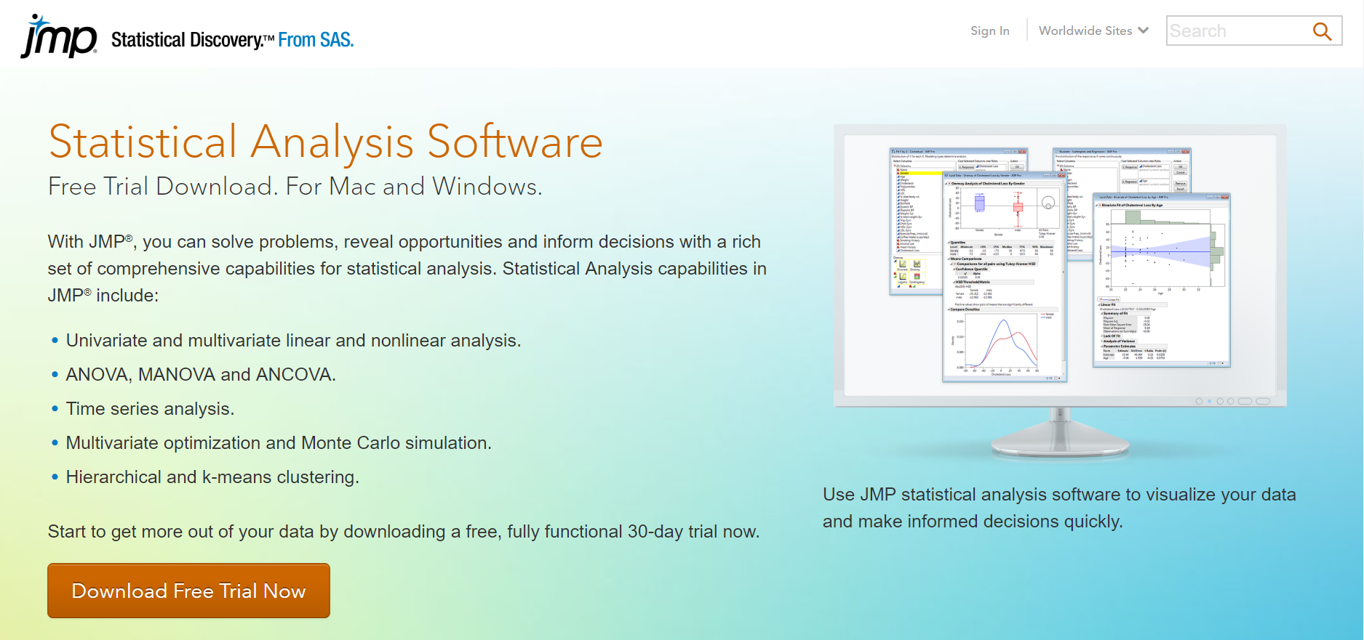
R
There has GOT to be an
APP for that!
Notes:
They ALWAYS used R and insisted it was required.
I thought they MUST be wrong. There has got to be an APP for that. (It’s a long story why I suspected this to be the case but that is for a conversation over coffee.)
Then the JMP Rep came to campus and did a presentation. I met with her after the presentation to ask a million questions, in particular, could this tool also “do” data science.

Slide 50
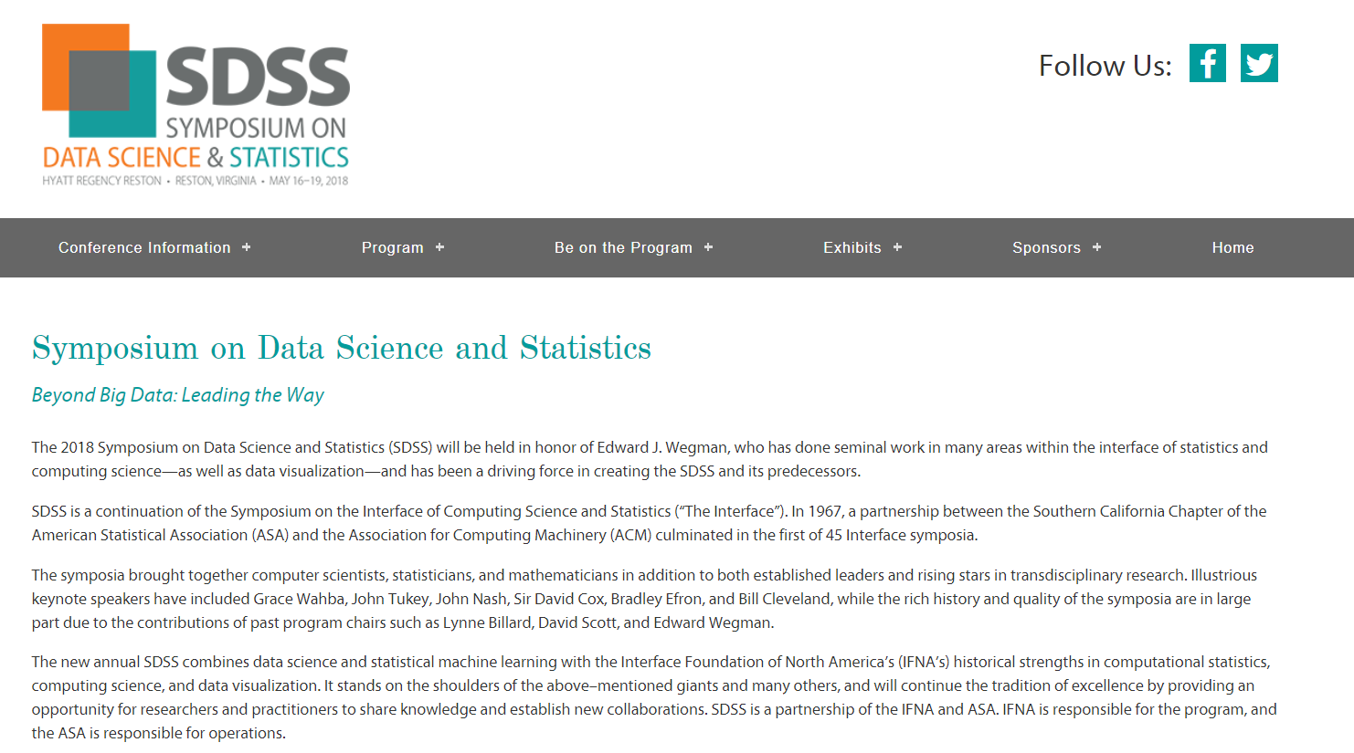
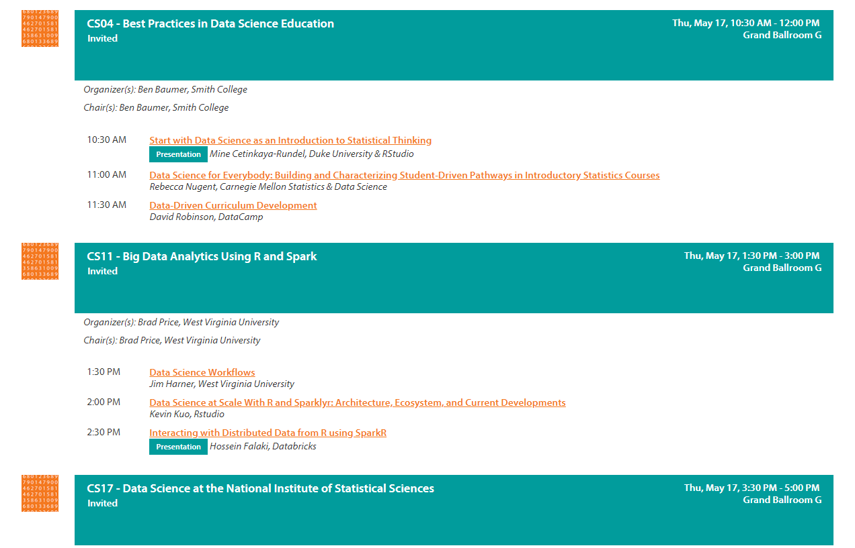
R
Notes:
I went to conferences to learn how to incorporate data science into my statistics class.
The conferences may as well have been R tutorials.

Slide 51
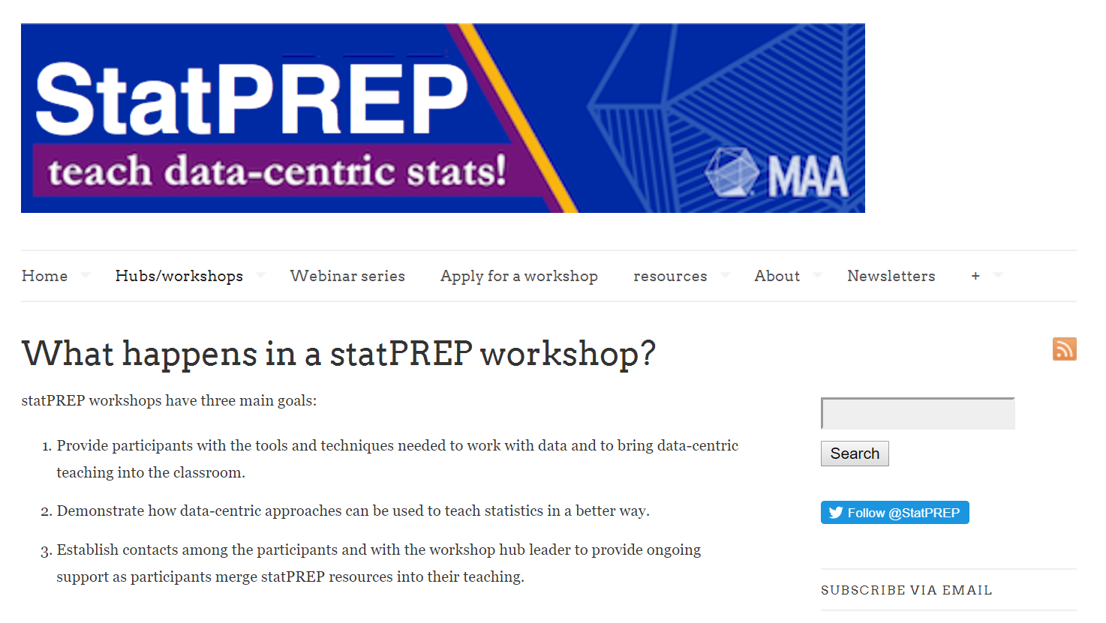
R
Notes:
The conferences may as well have been R tutorials.

Slide 52

“It’s all scales, no music."
If the cognitive overload of hand calculations stands in the way of statistical thinking, won’t coding do the same thing?
Notes:
Some of my students don’t remember the order of operations. I have had to teach them how to use a scientific calculator.
Granted this came as a shock to me since I used to teach econ students and they self select, they had a pretty high capacity to do math. Teaching math and stat in the general curriculum is very different.
And then I remembered the work of Shelia Tobias.

Slide 53
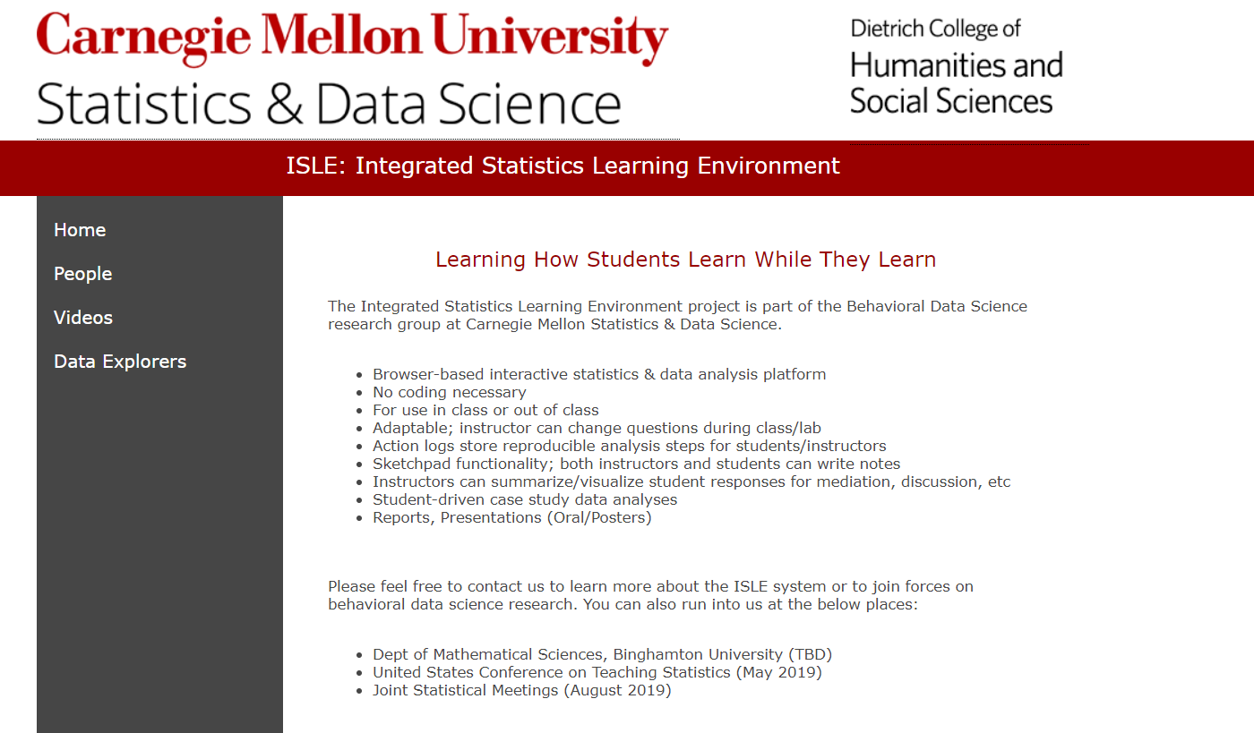

R
Notes:
At the conferences I learned of efforts to make R accessible to intro students.

Slide 54
Why not use R? Define Free.
NSF Award Number: 1418163
CodeR4STATS - Code R for AP Statistics
Awarded Amount to Date: $563,835
Award Abstract #1640041
Integrating Science, Mathematics, and Computing within an Elementary and Middle School Pre-Service Teacher Education Curriculum
Awarded Amount to Date: $700,608
Notes:
R is not FREE. The cost of R is not a direct cost. LOTS of money went into grants to build R. (and of course these also build careers).
I asked who would maintain these sights after the grant expired.

Slide 55
Award Abstract #1443068
CIF21 DIBBs: Building a Scalable Infrastructure for Data-Driven Discovery and Innovation in Education
Awarded Amount to Date: $5,320,819
Award Abstract #1625713
Enhancing Statistics Teacher Education with E-Modules
Awarded Amount to Date: $1,500,000
Notes:
I wondered if these were destined to become orphans like so many other things on the web.
It seemed like this is a job for THE MARKET! (Me, advocating the market! I never thought I would see the day after I resigned my tenure as an economics professor.)

Slide 56
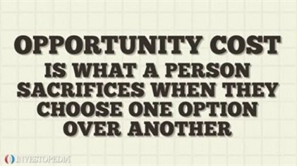
Opportunity costs are not restricted to monetary or financial costs: the real cost of output forgone, lost time, pleasure or any other benefit should also be considered an opportunity cost.
Notes:
The Opportunity Cost of using R is substantial.
Grants
Conferences
Cognitive load of the students
Bad statistical practice by lay practicioners.

Slide 57
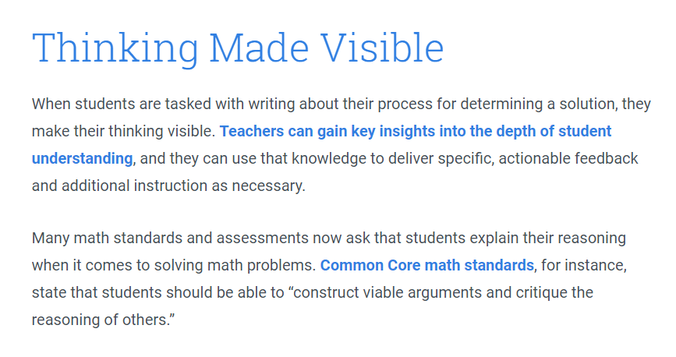
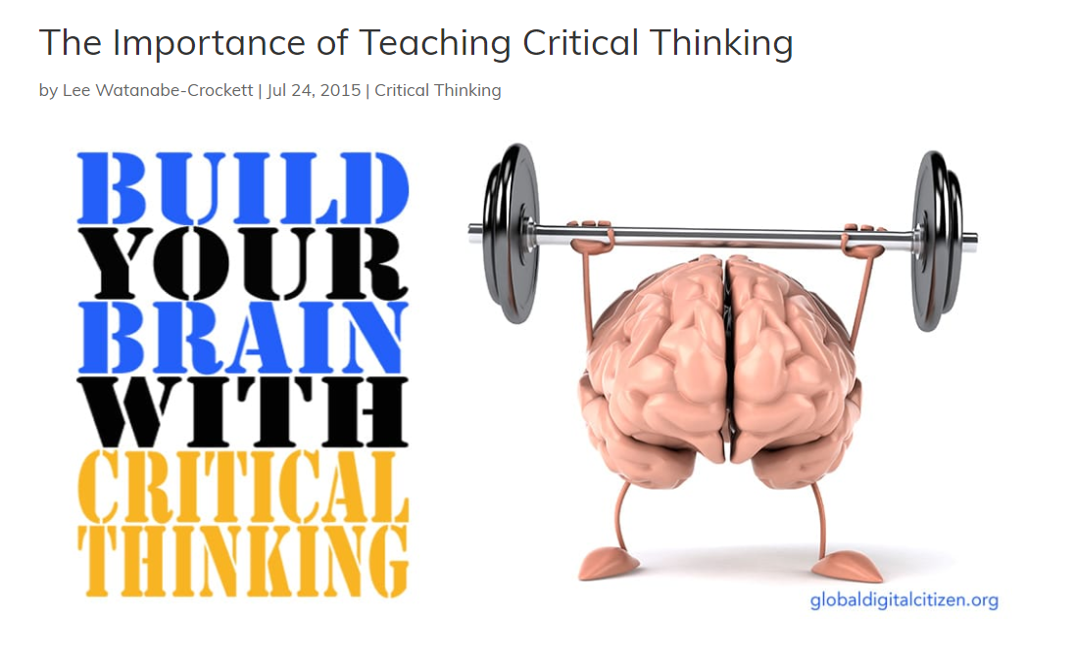
Where to go from here?
Writing Across the Curriculum
Critical Thinking Across the Curriculum
Notes:
Many years ago, Writing Across the Curriculum was the buzz word and we changed what we teach as a result.
More recently, Critical Thinking became the favorite buzz word.
Now it is AI and Data Science.

Slide 58

Where to go from here?
WEBER, VICTORIA LYNN. Defining the Relationship Between Learning Statistical Computing and a Student's Ability to Think and Reason Statistically. (Under the direction of Dr. Hollylynne Lee).
https://repository.lib.ncsu.edu/bitstream/handle/1840.20/35762/etd.pdf?sequence=1
Notes:
Young statisticians are thinking about what keeps their students from being able to DO statistics.
Projects to teach reproducibility are getting big grants to spread the word and create a community of teachers who want to TEACH reproduce ibility in Empirical Research.

Slide 59
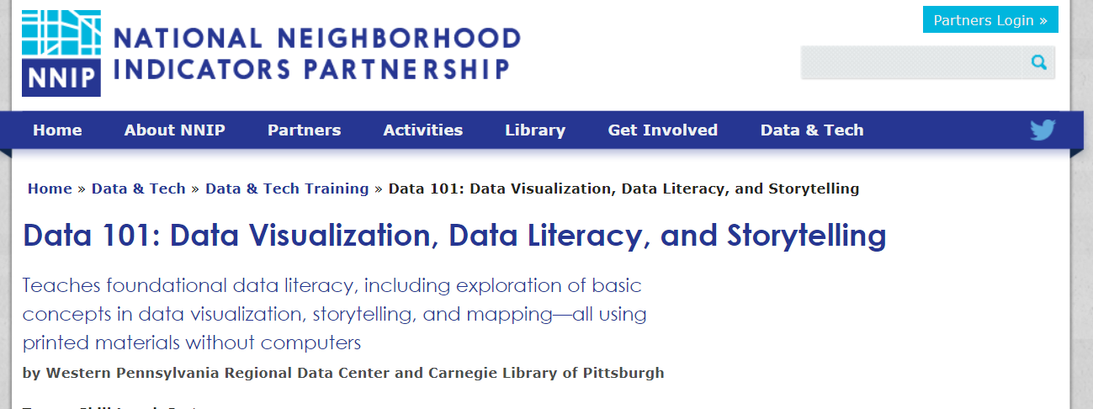

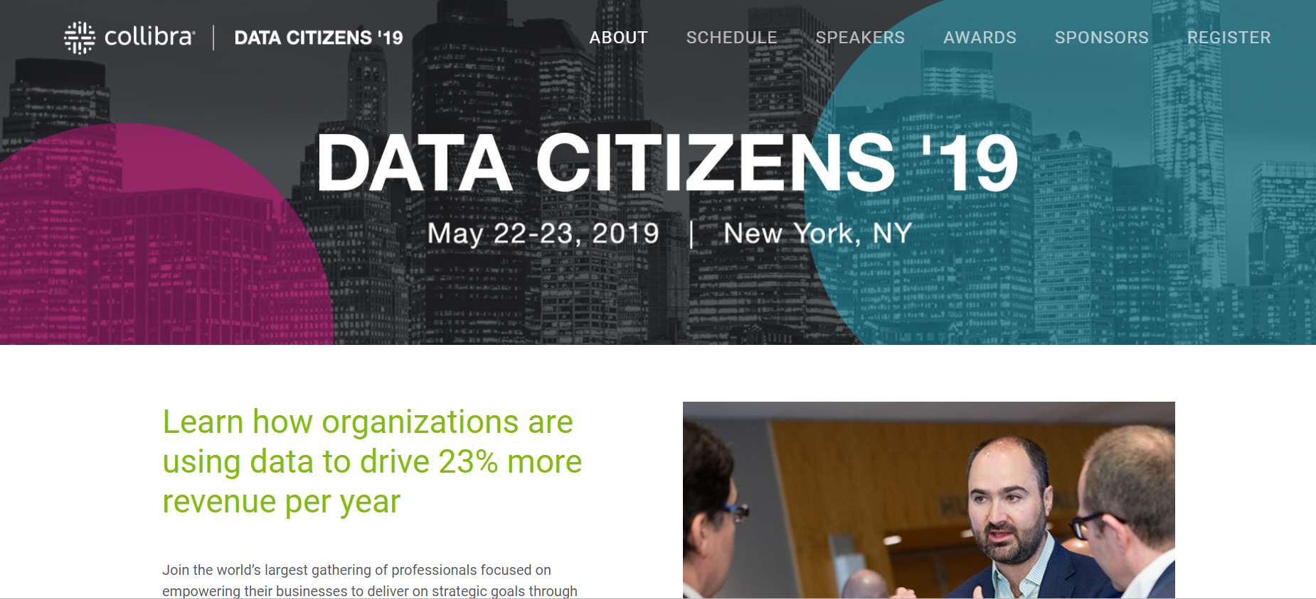

Notes:
If we don’t change, we will become irrelevant.

Slide 60
