Slide 1
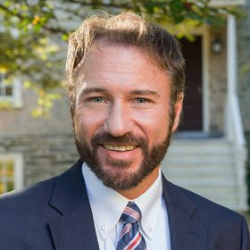
Teaching Students Transparent and Reproducible Research Methods with the TIER Protocol
Norm Medeiros
Associate Librarian, Haverford College
Director, Project TIER
Methods on the Agenda
15 March 2019
Project TIER is supported by the Alfred P. Sloan Foundation
www.projecttier.org
@Project_TIER

Slide 2
Haverford (PA), USA (ca. 7 miles west of Philadelphia)
highly-selected liberal arts college
1,300 students, 135 faculty
founded in 1833
www.projecttier.org
@Project_TIER

Slide 3
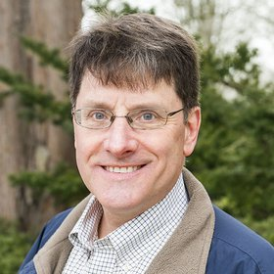
Project TIER (Teaching Integrity in Empirical Research)
Richard Ball, Professor of Economics, and I sought to help students (and ourselves) better understand the quantitative work they were conducting.
2000-2005: recognition of problem, small steps to improve outcomes
2006-2012: development of more specific guidelines (e.g., submission of electronic files)
2013: launch of Project TIER; development of TIER Protocol 1.0; Alfred P. Sloan Foundation funding
www.projecttier.org
@Project_TIER

Slide 4
image courtesy of The Conversation (http://theconversation.com/)
www.projecttier.org
@Project_TIER

Slide 5
image courtesy of KissCC0 (https://www.kisscc0.com)
www.projecttier.org
@Project_TIER

Slide 6
Project TIER (Teaching Integrity in Empirical Research)
Mission & Goals
● Promote the integration of principles and practices related to transparency and reproducibility in the research training of social scientists
● Help students manage and understand their research processes and analysis through adherence to the TIER Protocol
● Help instructors advise students by seeing their research in action
www.projecttier.org
@Project_TIER

Slide 7
Project TIER (Teaching Integrity in Empirical Research)
Faculty Development Workshops
● Held 2-3 times per year; 1-1.5 days; generally 8-12 attendees
● No registration fee; travel stipends available
● Designed for instructors who want to incorporate
transparent research methods into their teaching or advising
● Focal point is the TIER Protocol; also feature Rmarkdown,
OSF, and special topics; most recent workshop held March 12-13, 2019 at St. Anne’s College, Oxford
www.projecttier.org
@Project_TIER

Slide 8
Project TIER (Teaching Integrity in Empirical Research)
Faculty Fellows Program
● Year-long fellowships awarded to individuals interested in playing a leadership role in outreach and curriculum building
● Applications for 2019-2020 Fellowships are being accepted through April 8, 2019
● Example projects: pre-registration template; SPSS-specific protocol; video tutorials for student use
www.projecttier.org
@Project_TIER

Slide 9
Project TIER (Teaching Integrity in Empirical Research)
Course Materials
● 19 syllabi and related materials from 12 institutions dating back to 2014
● Soup-to-Nuts exercises that relay principles of reproducibility in a shorter timeframe than a semester-long research project
● Open Stats Lab/Project TIER preregistration template
● Examples of fully-reproducible student projects
www.projecttier.org
@Project_TIER

Slide 10
Project TIER (Teaching Integrity in Empirical Research)
TIER Protocol: Specifications & Process
● Specifications: What are the end results
● Process: How do you get there
→ Activities that support reproducibility need to occur contemporaneously with the research process; they cannot be effectively retrofitted once an empirical research project is complete.
www.projecttier.org
@Project_TIER

Slide 11
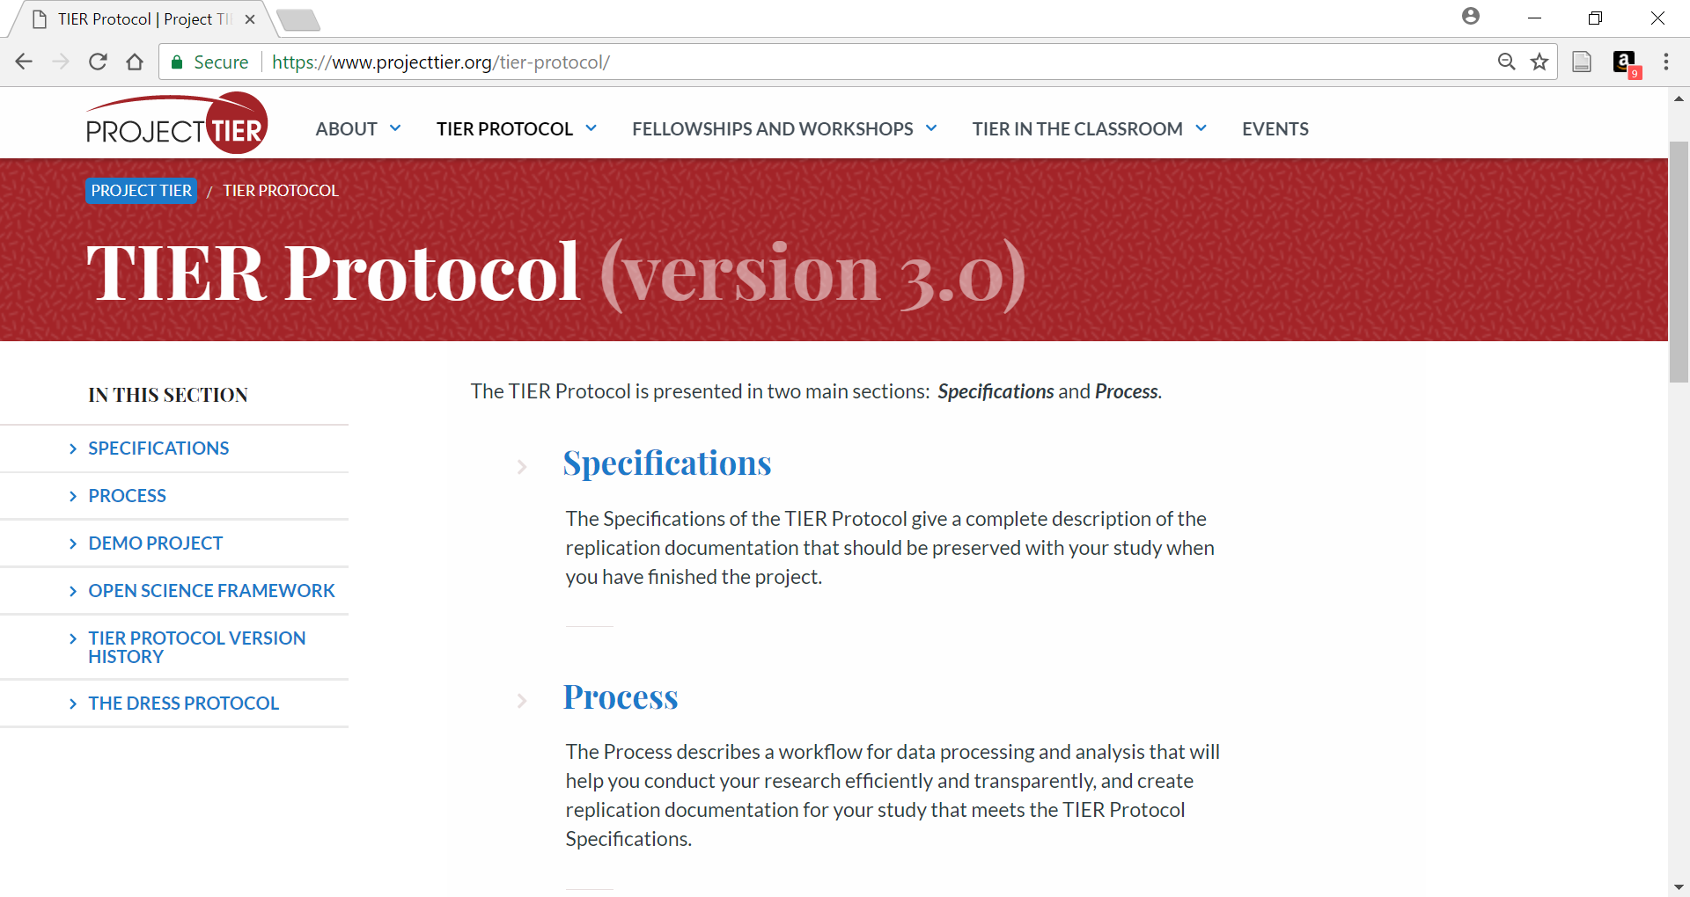
www.projecttier.org
@Project_TIER

Slide 12
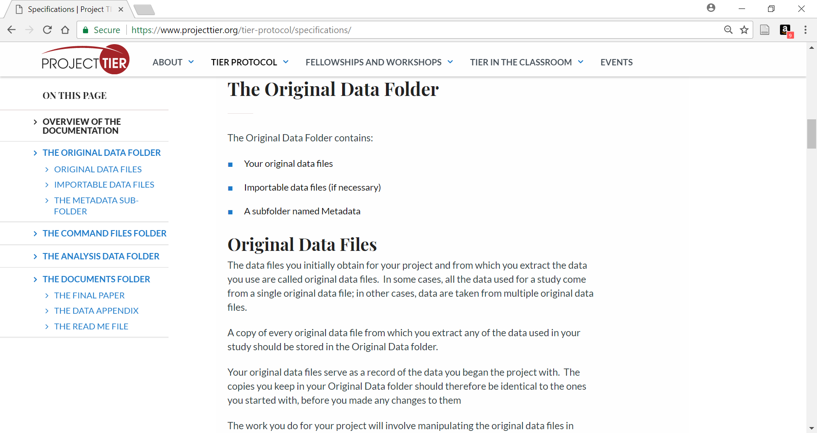
www.projecttier.org
@Project_TIER

Slide 13
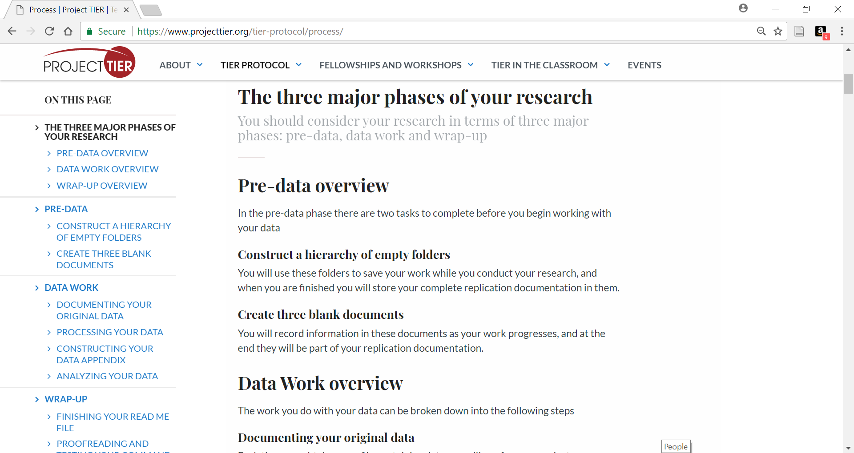
www.projecttier.org
@Project_TIER

Slide 14
www.projecttier.org
@Project_TIER

Slide 15
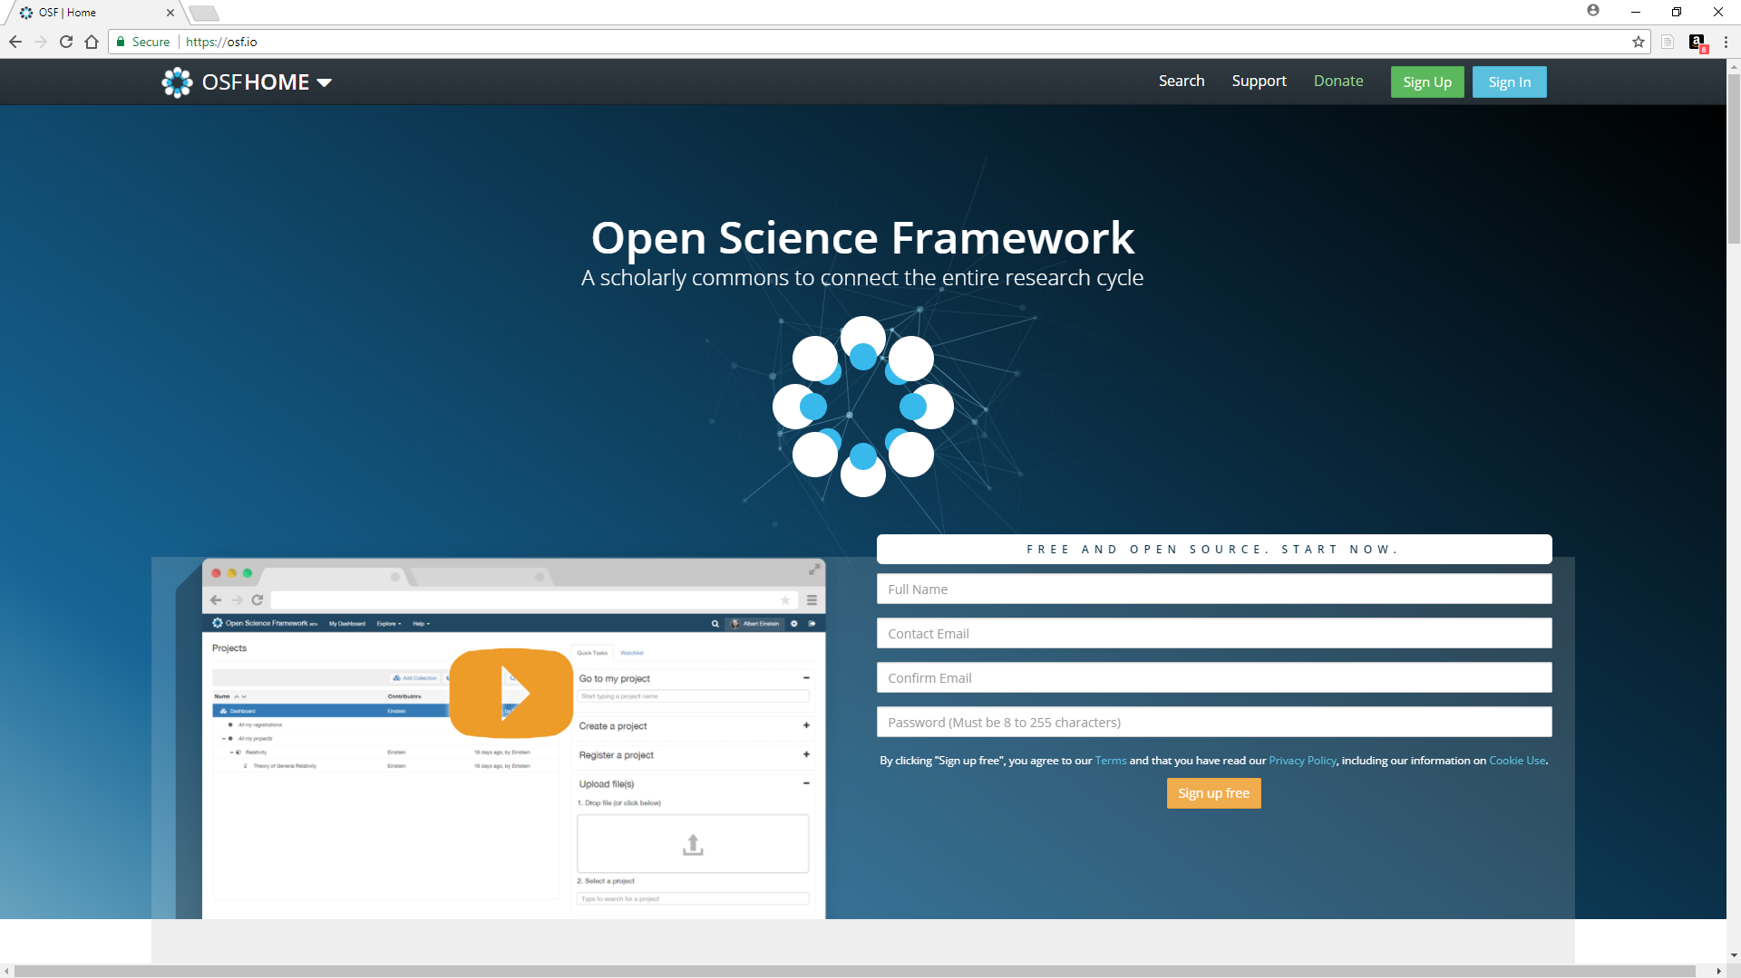
Open Science Framework
● Unlimited free storage
● Easy to use
● Private/Public projects
● Supports collaboration
● Interfaces with productivity apps
● Flexible authorization
● Version control
● Pre-registration tool
● Good online and personal help
www.projecttier.org
@Project_TIER

Slide 16
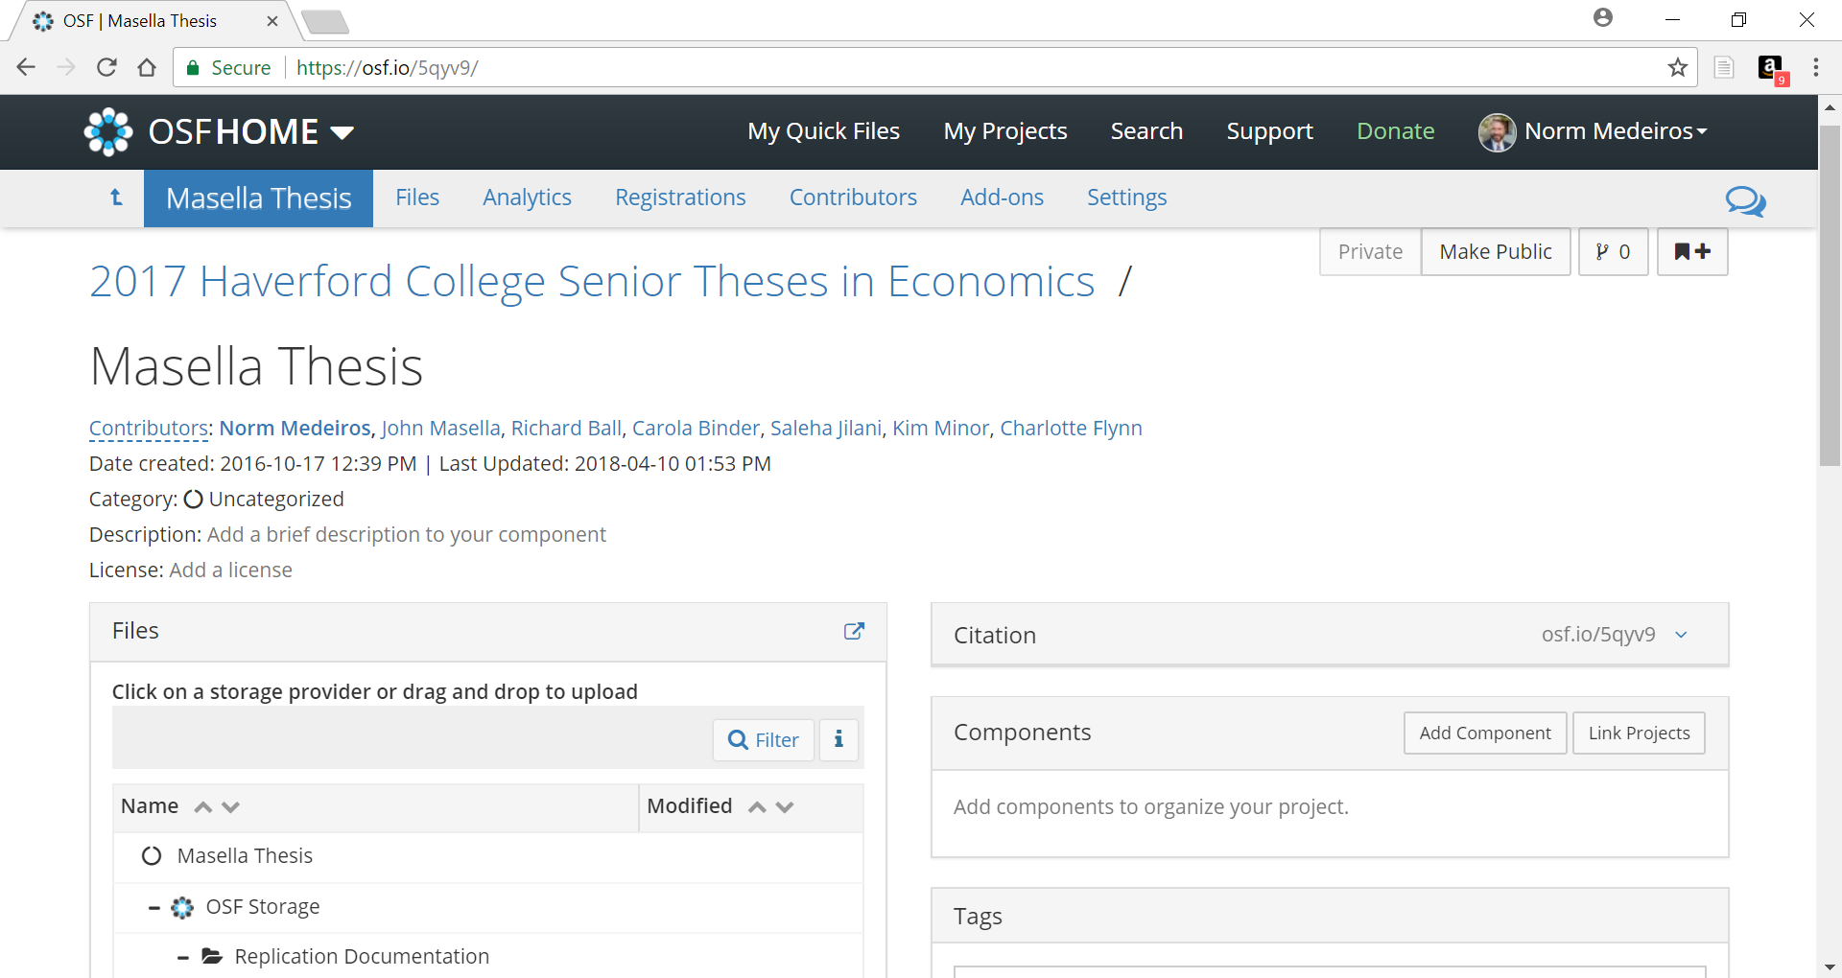
www.projecttier.org
@Project_TIER

Slide 17
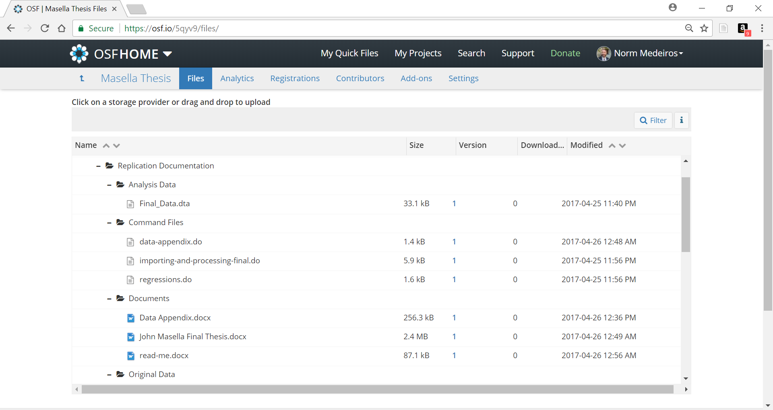
www.projecttier.org
@Project_TIER

Slide 18
Project TIER (Teaching Integrity in Empirical Research)
/*
When this do-file is executed, Stata's working directory should be set to the
Do File's folder
*/
clear
set more off
*make a folder to store temporary output
capture mkdir ../temp
*open up original WDI data
import excel using ../OriginalData/WDI/DataFiles/wdi.xlsx, cellrange(A1:AZ6955) firstrow
● Syntax Files
→ the foundation of reproducibility
easy to make changes
easy to roll back in OSF
relative path directories
support portability
- comment liberally!
www.projecttier.org
@Project_TIER

Slide 19
Project TIER (Teaching Integrity in Empirical Research)
● Metadata Guide
Citation for original data plus
names & definitions of variables to be used in analysis; units of
measurement; number of observations; file structure
Purpose: help students better understand their inputs
www.projecttier.org
@Project_TIER

Slide 20
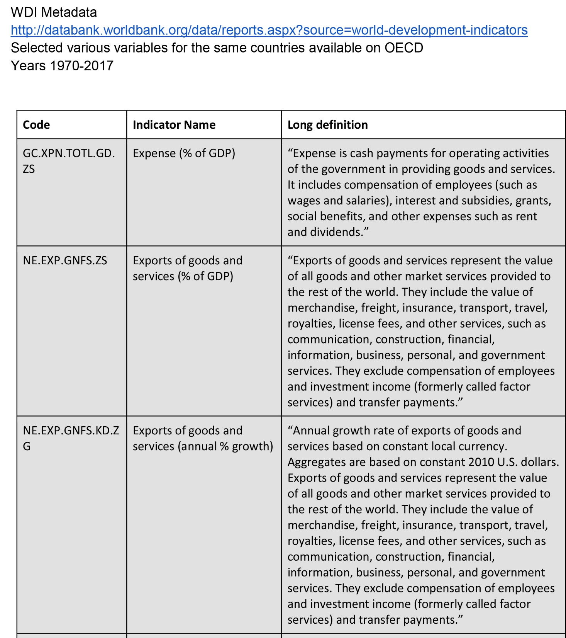
Metadata Guide

Slide 21
Project TIER (Teaching Integrity in Empirical Research)
….a word about data citation
World Bank. (2016). World Development Indicators. http://databank.worldbank.org/data/reports.aspx?source=world-development-indicators/. Accessed: 20160406.
Additional information: Selected China and India from the “Country” table. Selected “Lending interest rate (%)” from the “Series” table. Selected 2010-2014 from the “Time” table. Downloaded as .csv file.
www.projecttier.org
@Project_TIER

Slide 22
Project TIER (Teaching Integrity in Empirical Research)
● Data Appendix
A codebook for analysis data
names & definitions of variables; name of the original data file(s)
from which the variables were extracted; number of observations & observations with missing values
→ summary statistics and histogram (for quantitative variables) and frequency table and bar chart (for categorical variables)
www.projecttier.org
@Project_TIER

Slide 23
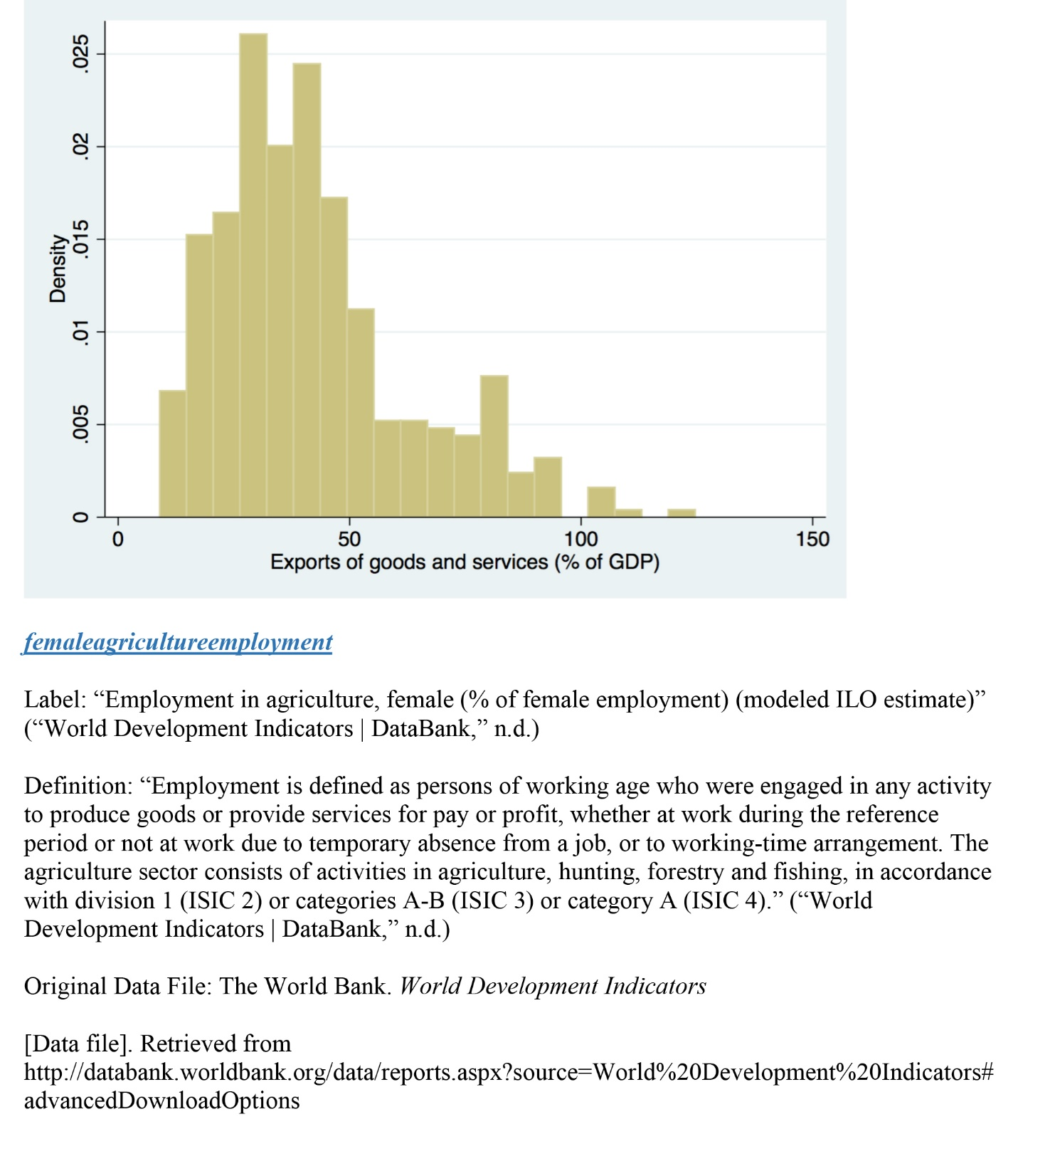
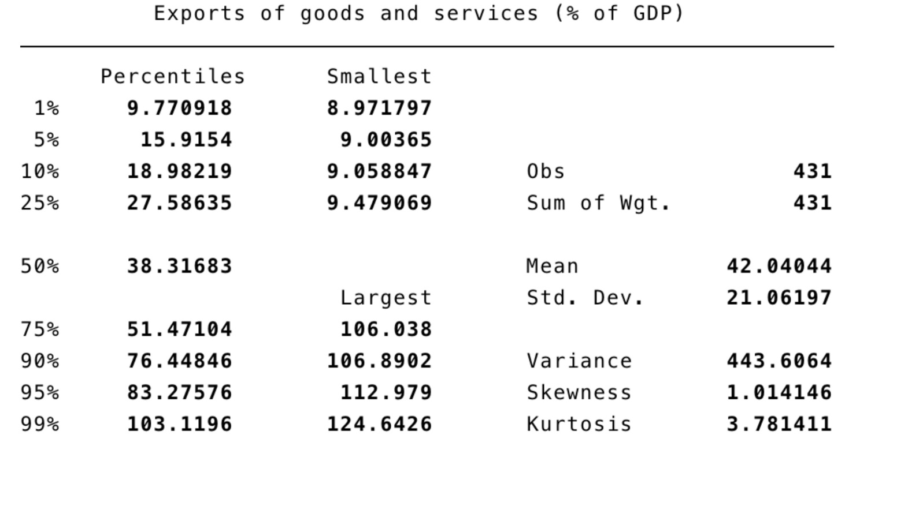
Data Appendix

Slide 24
Project TIER (Teaching Integrity in Empirical Research)
● readme file
- transformations to convert original data into importable data
- software versions & packages
- overview of folders and files, and instructions for running them
- special instructions, such as setting a working directory
www.projecttier.org
@Project_TIER

Slide 25
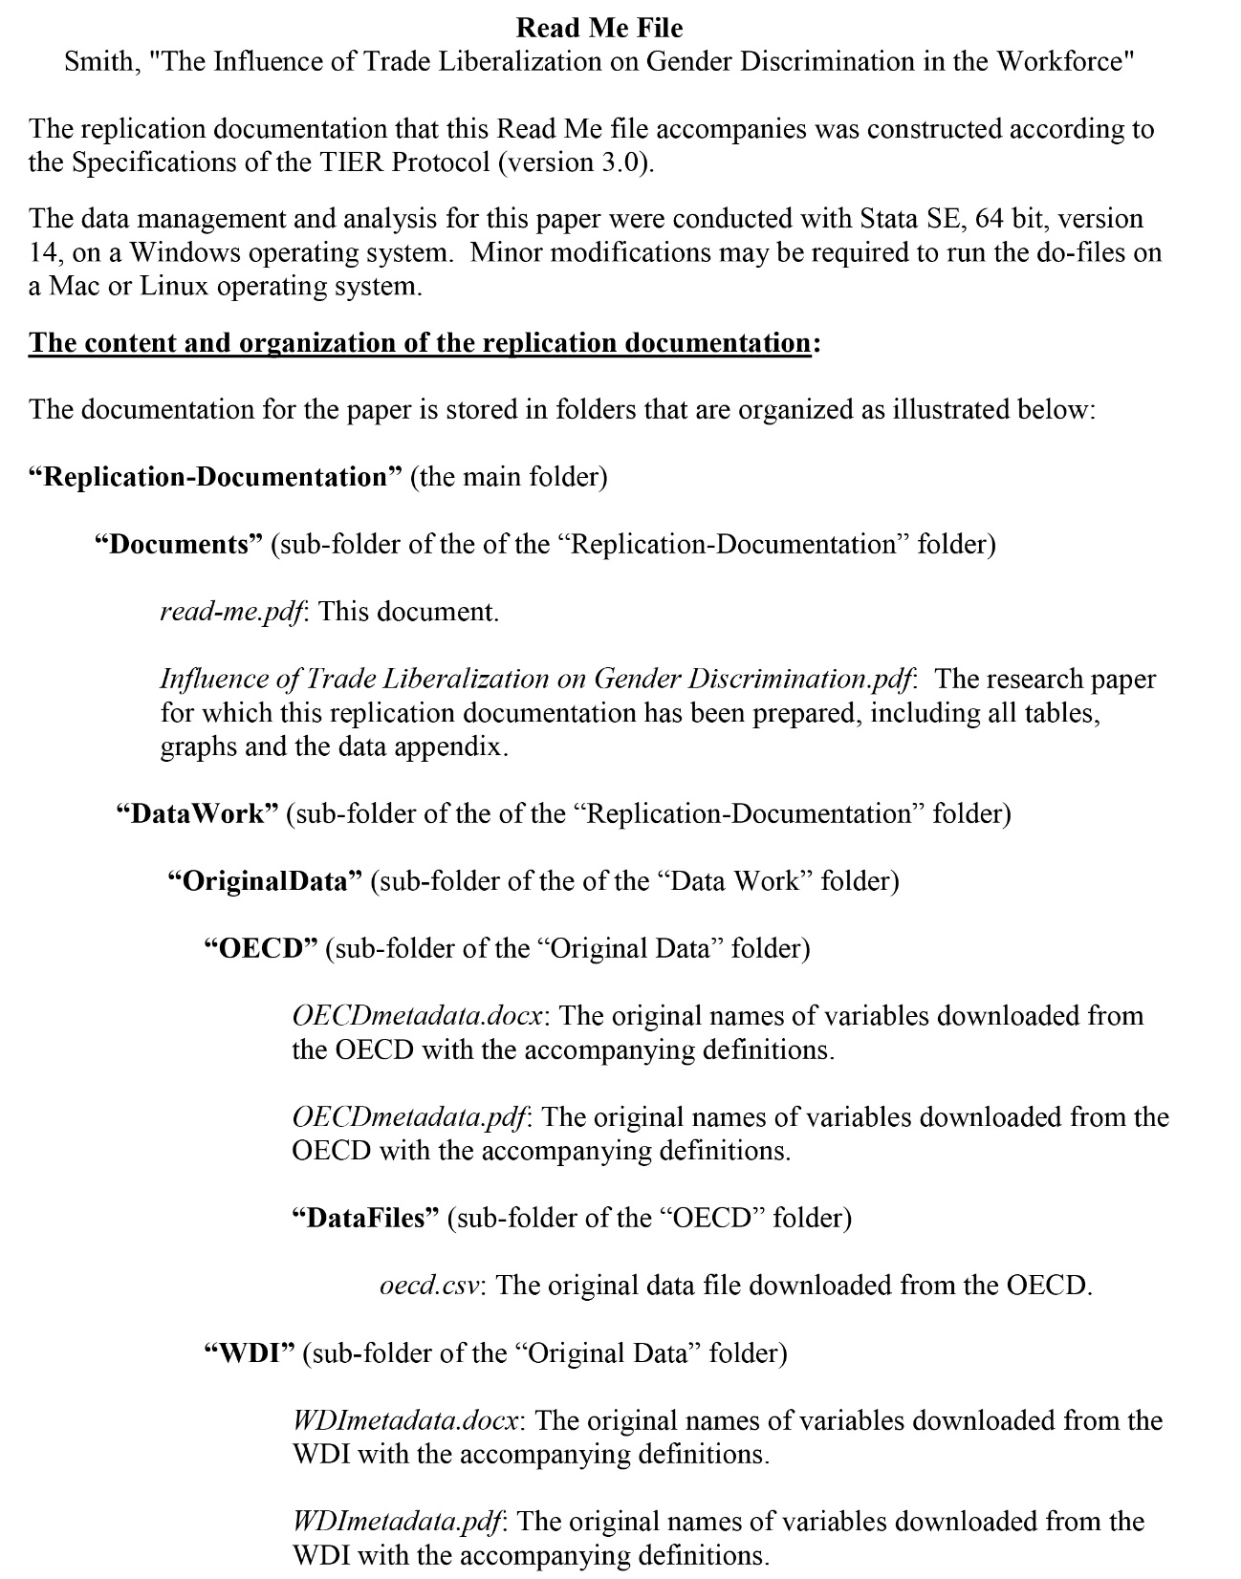
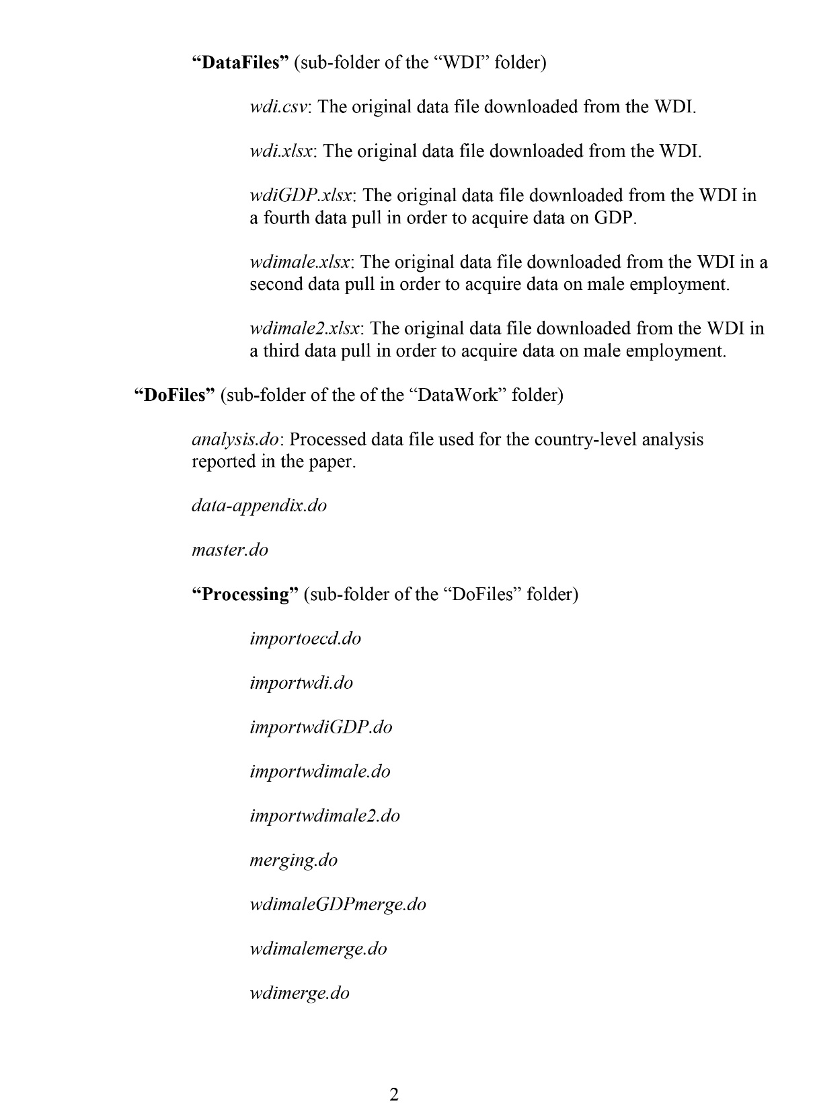
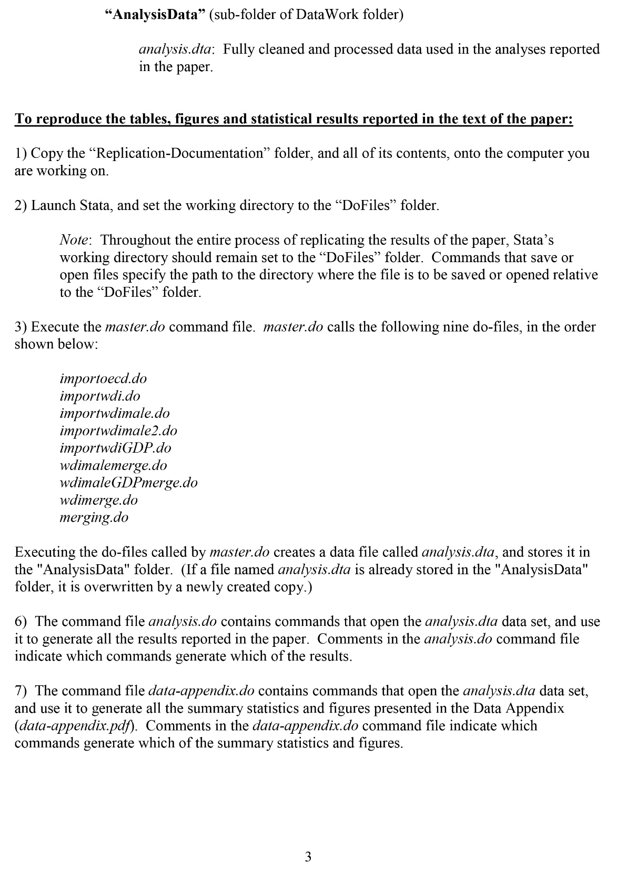
readme file

Slide 26
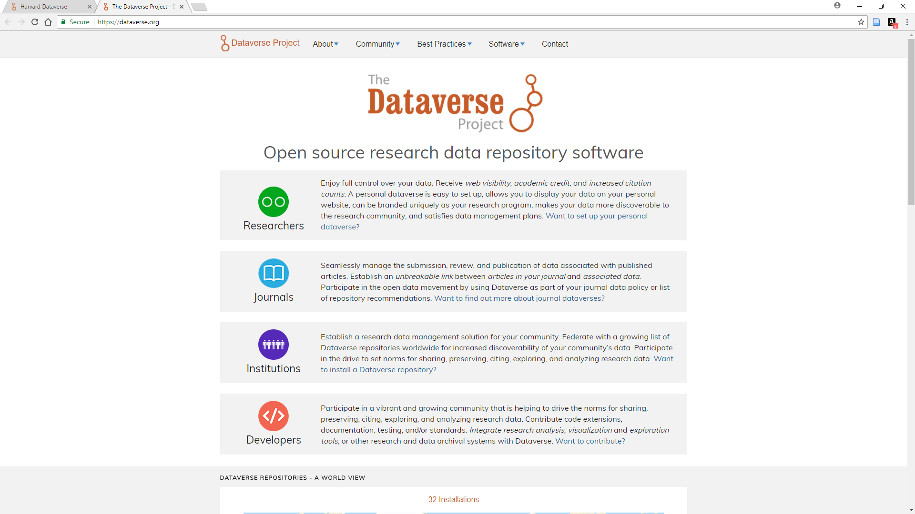
Dataverse
● Free storage up to 1TB
● Robust metadata support
● Rich search options
● Numerous roles
● File access control
● Version control
● Several authentication options
● Hosted, with branding, or local installation with customizations
www.projecttier.org
@Project_TIER

Slide 27
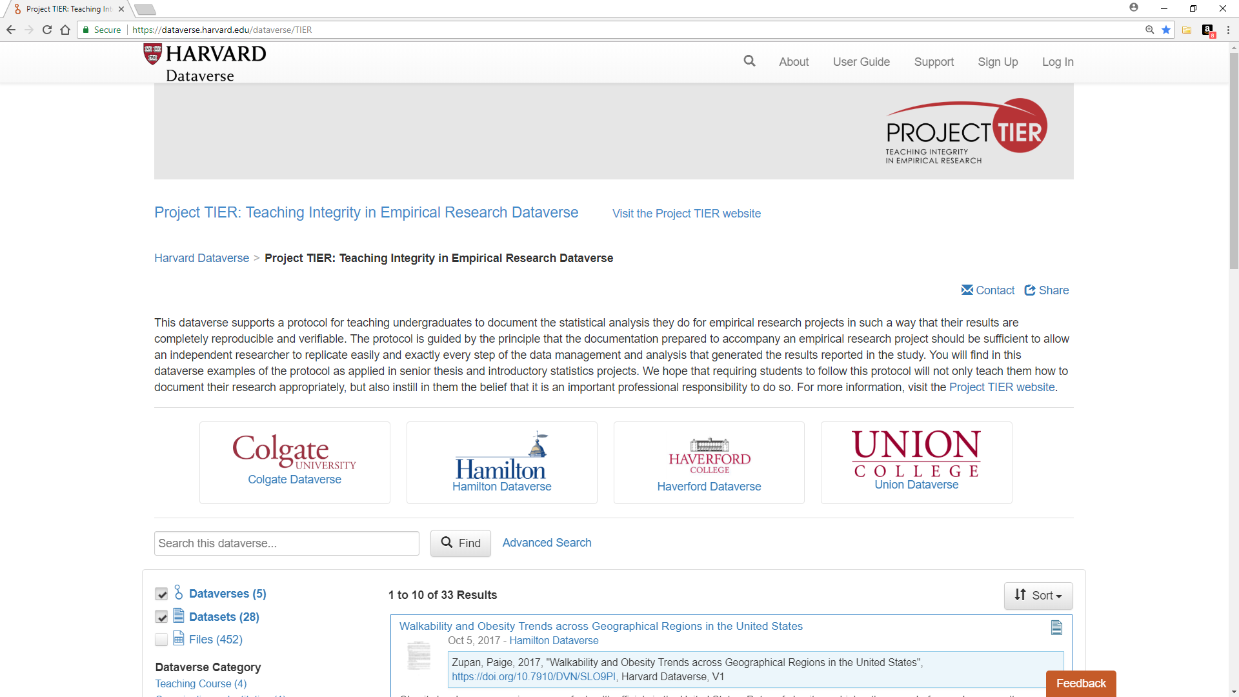
● show Dataverse example
www.projecttier.org
@Project_TIER

Slide 28
Project TIER (Teaching Integrity in Empirical Research)
● To learn more
- https://projecttier.org
- “Teaching Integrity in Empirical Economics: The Pedagogy of Reproducible Science in Undergraduate Education" in Undergraduate Research & the Academic Librarian (Chicago: ACRL, 2017) [available for download at goo.gl/rUHNXd ]
www.projecttier.org
@Project_TIER

