Slide 1
Trickle Up Transparency:
Teaching Reproducible Methods to Undergraduates
Norm Medeiros
Associate Librarian, Haverford College
Director, Project TIER
IASSIST & CARTO 2018
31 May 2018
Project TIER is supported by the Alfred P. Sloan Foundation
www.projecttier.org
@Project_TIER

Slide 2
Project TIER (Teaching Integrity in Empirical Research)
● Promotes the integration of principles and practices related to transparency and reproducibility in the research training of social scientists
Evolutionary, not revolutionary
www.projecttier.org
@Project_TIER

Slide 3
Project TIER (Teaching Integrity in Empirical Research)
● Sought to help students (and ourselves) better understand the quantitative work they were conducting
2000-2005: recognition of problem, small steps to improve outcomes
2006-2012: development of more specific guidelines (e.g., submission of electronic files)
2013- launch of Project TIER; development of TIER Protocol 1.0
www.projecttier.org
@Project_TIER

Slide 4
Project TIER (Teaching Integrity in Empirical Research)
● TIER Protocol: Specifications & Process
Specifications = What are the end results
Process = How do you get there
www.projecttier.org
@Project_TIER

Slide 5
www.projecttier.org
@Project_TIER

Slide 6
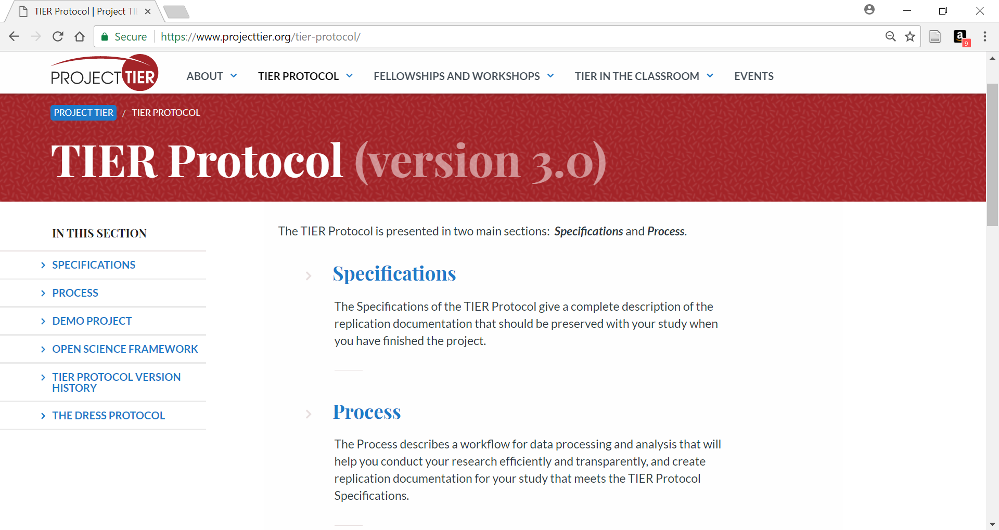
www.projecttier.org
@Project_TIER

Slide 7
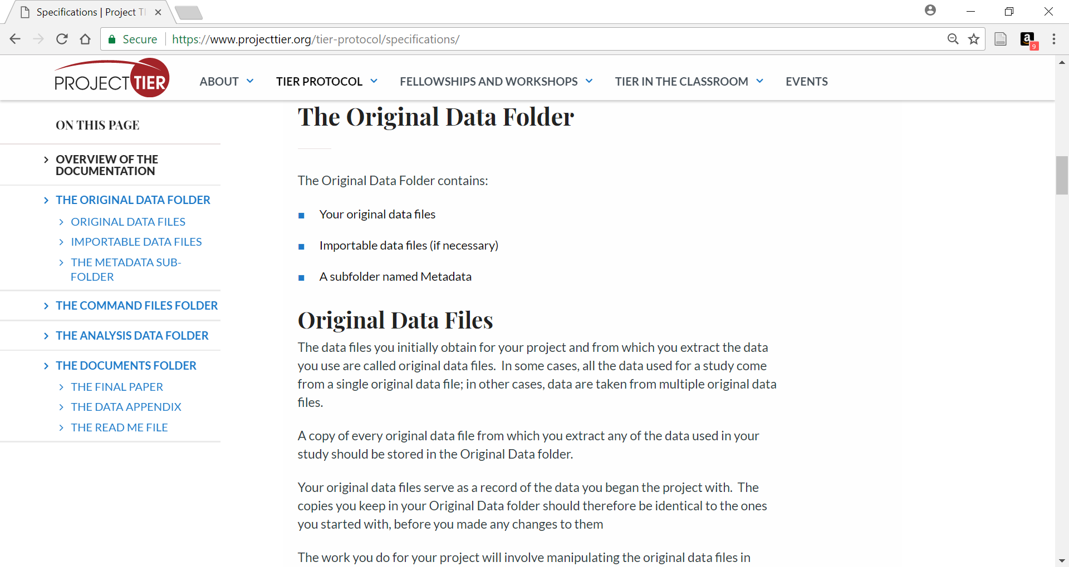
www.projecttier.org
@Project_TIER

Slide 8
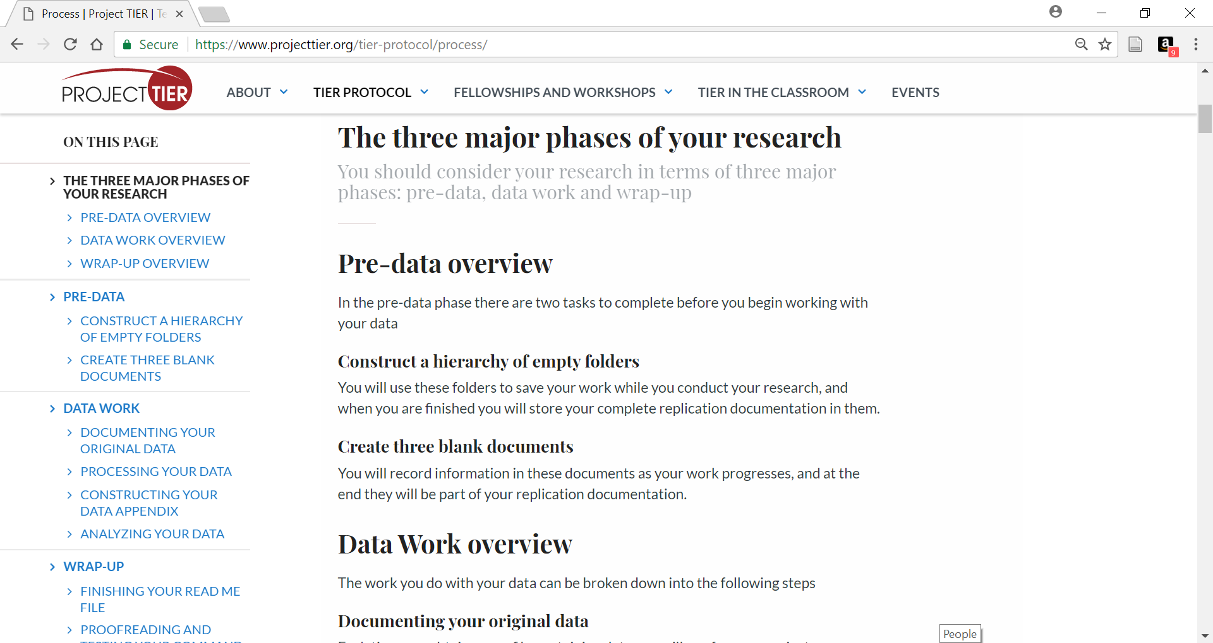
www.projecttier.org
@Project_TIER

Slide 9
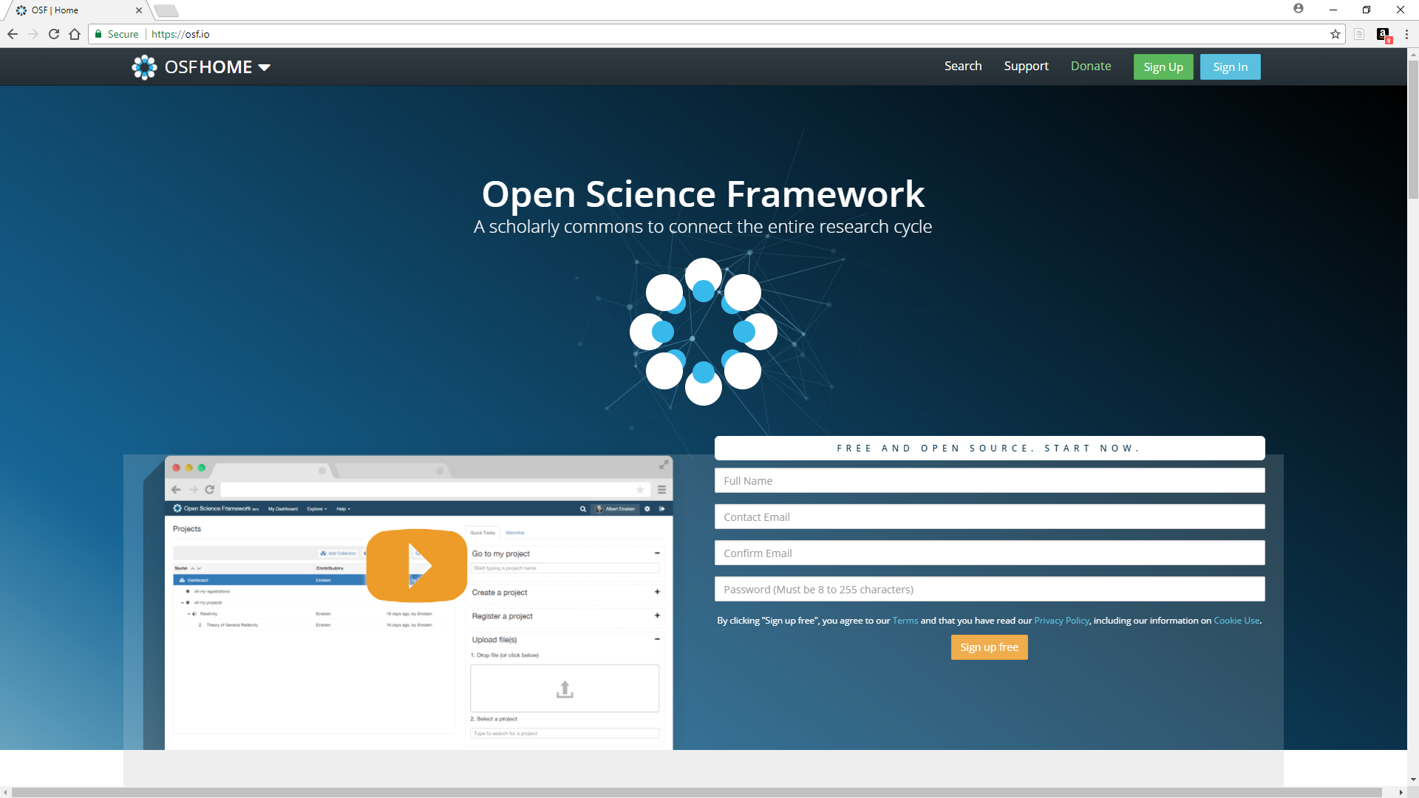
Open Science Framework
● Unlimited free storage
● East to use
● Private/Public projects
● Supports collaboration
● Interfaces with productivity apps
● Flexible authorization
● Version control
● Pre-registration tool
● Good online and personal help
www.projecttier.org
@Project_TIER

Slide 10
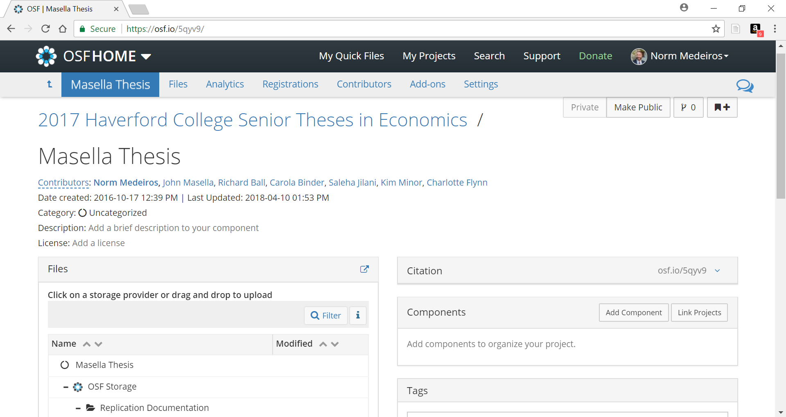
www.projecttier.org
@Project_TIER

Slide 11
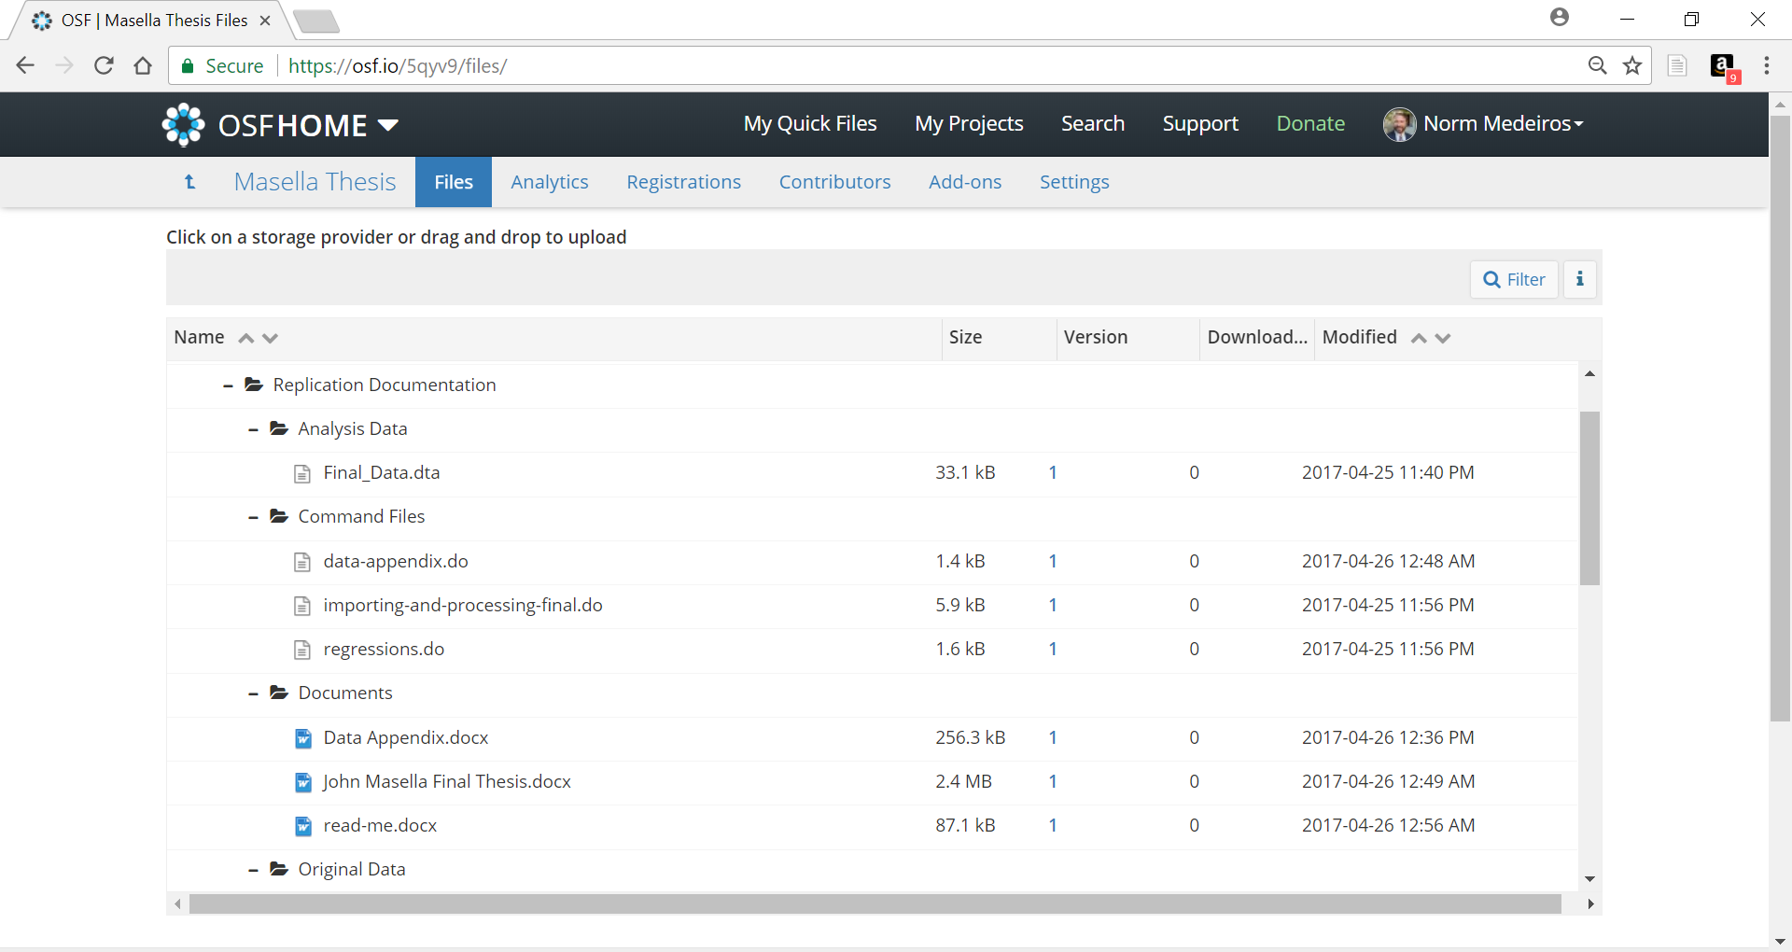
www.projecttier.org
@Project_TIER

Slide 12
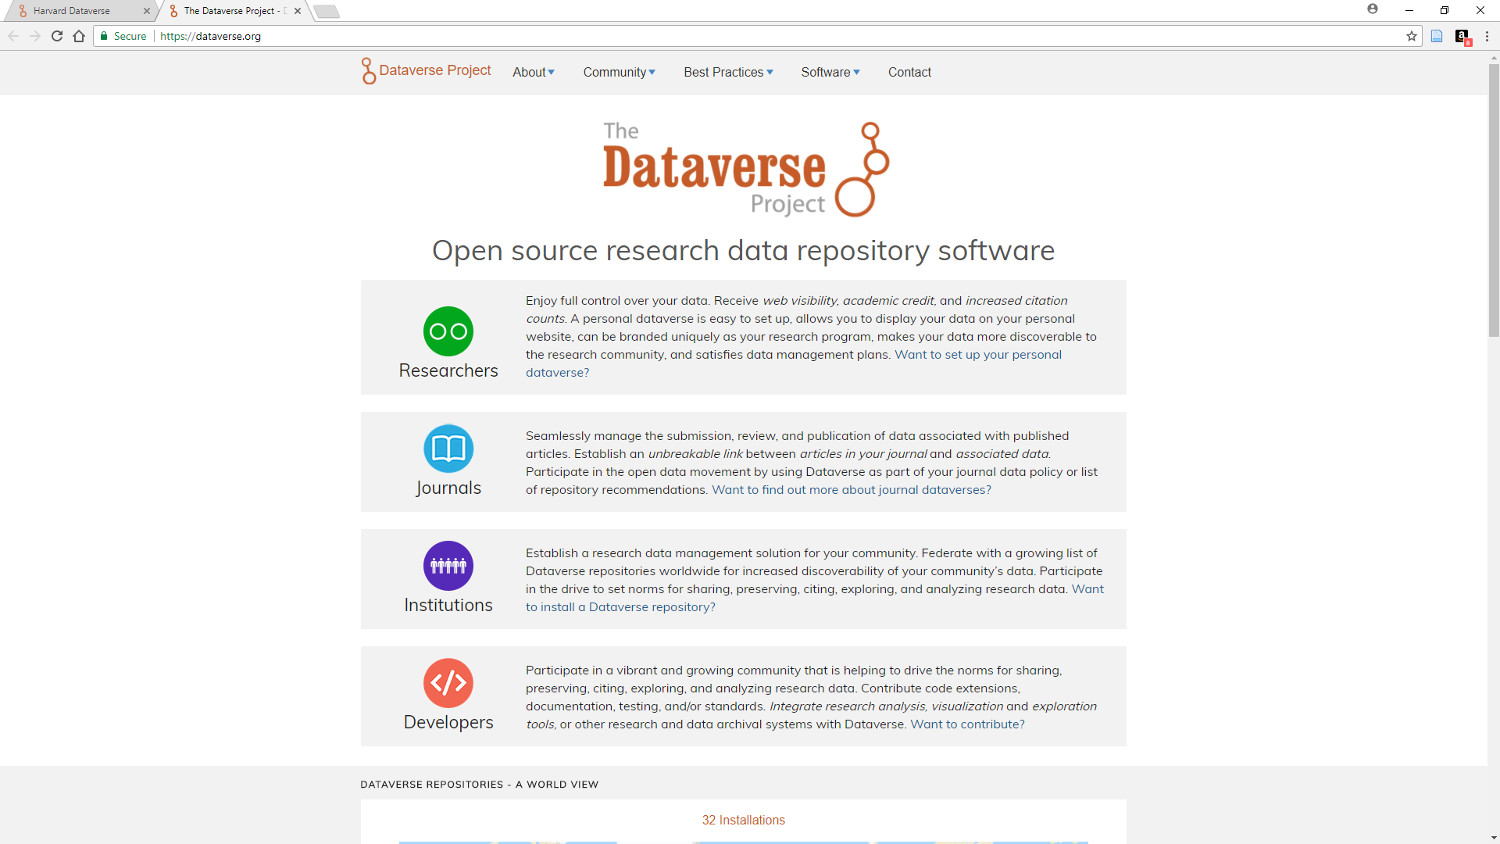
Dataverse
● Free storage up to 1TB
● Robust metadata support
● Rich search options
● Numerous roles
● File access control
● Version control
● Several authentication options
● Hosted, with branding, or local installation with customizations
www.projecttier.org
@Project_TIER

Slide 13
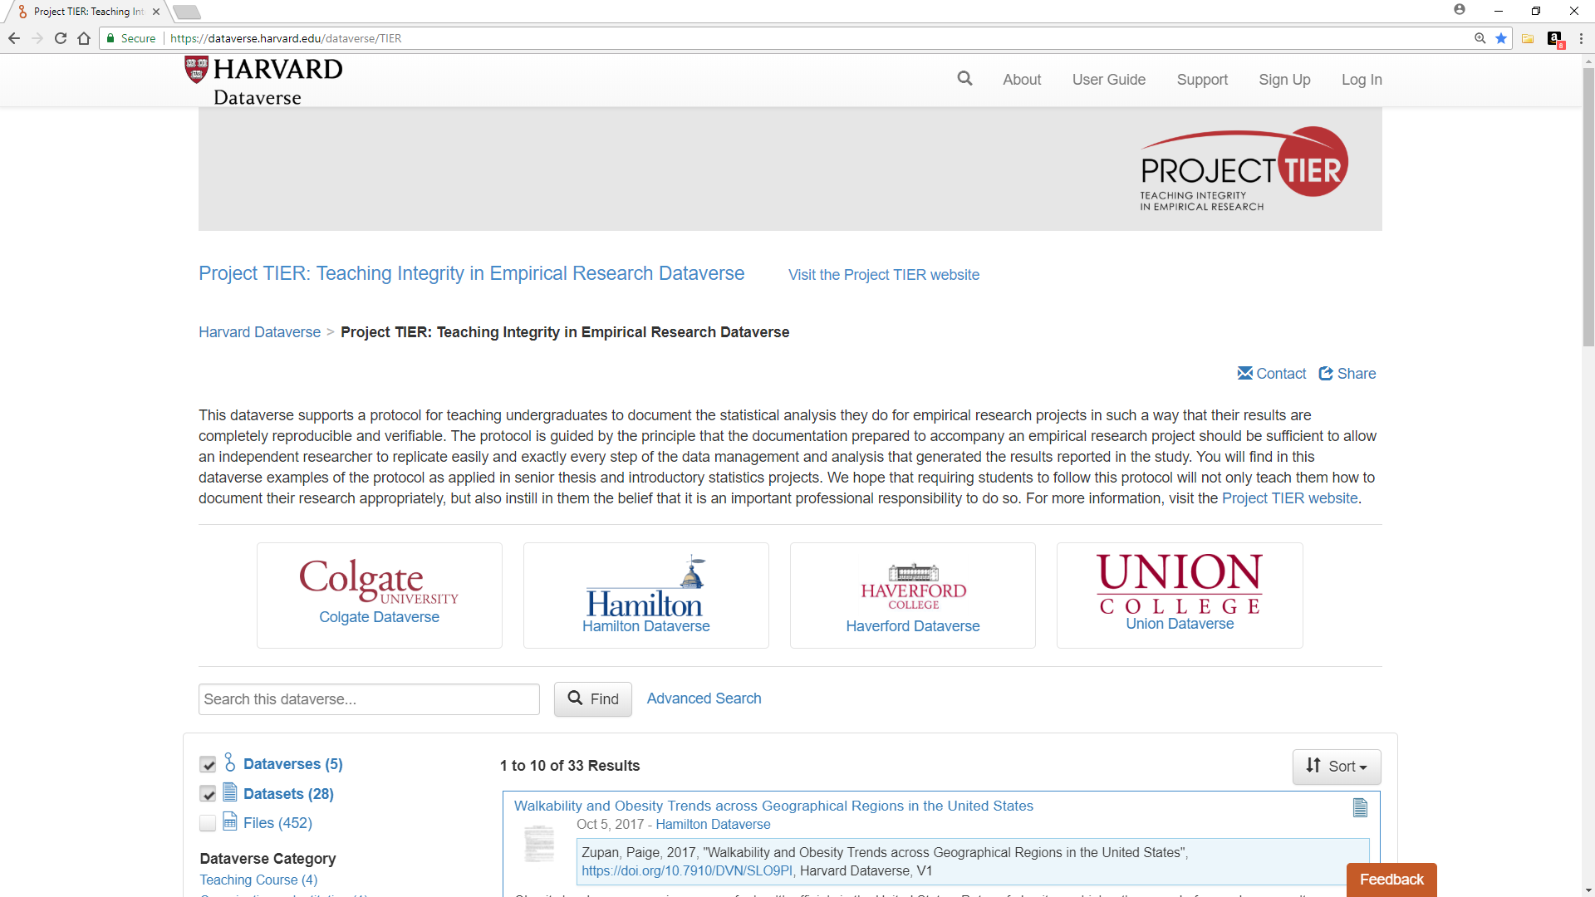
● show Dataverse example
www.projecttier.org
@Project_TIER

Slide 14
Project TIER (Teaching Integrity in Empirical Research)
● Faculty Development Workshops
- Held 2-3 times per year; 1-1.5 days each; generally 8-12 attendees
- No registration fee; travel stipends available
- Designed for instructors who want to incorporate transparent research methods into their teaching or advising
- Focal point is TIER Protocol; also feature Rmarkdown, OSF, and special topics
www.projecttier.org
@Project_TIER

Slide 15
Project TIER (Teaching Integrity in Empirical Research)
● Faculty Fellows Program
- Year-long fellowships awarded to individuals interested in playing a leadership role in outreach and curriculum building
- Recently awarded 2018/19 Fellows are the 4th cohort
- Example projects: pre-registration template; SPSS-specific protocol; video tutorials for student use
- Bios posted on TIER web site
www.projecttier.org
@Project_TIER

Slide 16
Project TIER (Teaching Integrity in Empirical Research)
● Course Materials
- 20 syllabi and related materials from 12 institutions dating back to 2014
- Provide insights into incorporating TIER principles into courses across the social sciences
- Will be developing exercises this year for teaching statistical analysis using various applications (Stata, R, SPSS)
www.projecttier.org
@Project_TIER

Slide 17
Project TIER (Teaching Integrity in Empirical Research)
● Preregistration Template
Jointly developed by Ben Le (2017-18 TIER Fellow) and
Kevin McIntyre (Open Stats Lab)
- Less comprehensive than OSF template; designed for student use (undergraduate & graduate)
- Usable in all quantitative fields
www.projecttier.org
@Project_TIER

Slide 18
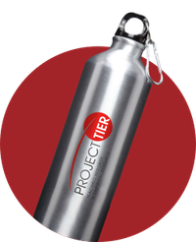
Project TIER (Teaching Integrity in Empirical Research)
● TIER resources
- Tell us if you’re using our materials
- Let us know how we can make our
materials more useful
- Tell us what we aren’t we providing that
we should
www.projecttier.org
@Project_TIER

Slide 19
Project TIER (Teaching Integrity in Empirical Research)
● To learn more
- https://projecttier.org
- 2018 Annual Conference of the American Political Science Association (Aug 30-Sept. 2, 2018, Boston, MA)
- “Teaching Integrity in Empirical Economics: The Pedagogy of Reproducible Science in Undergraduate Education" in Undergraduate Research & the Academic Librarian (Chicago: ACRL, 2017) [available for download at goo.gl/rUHNXd ]
www.projecttier.org
@Project_TIER

